Slide 1
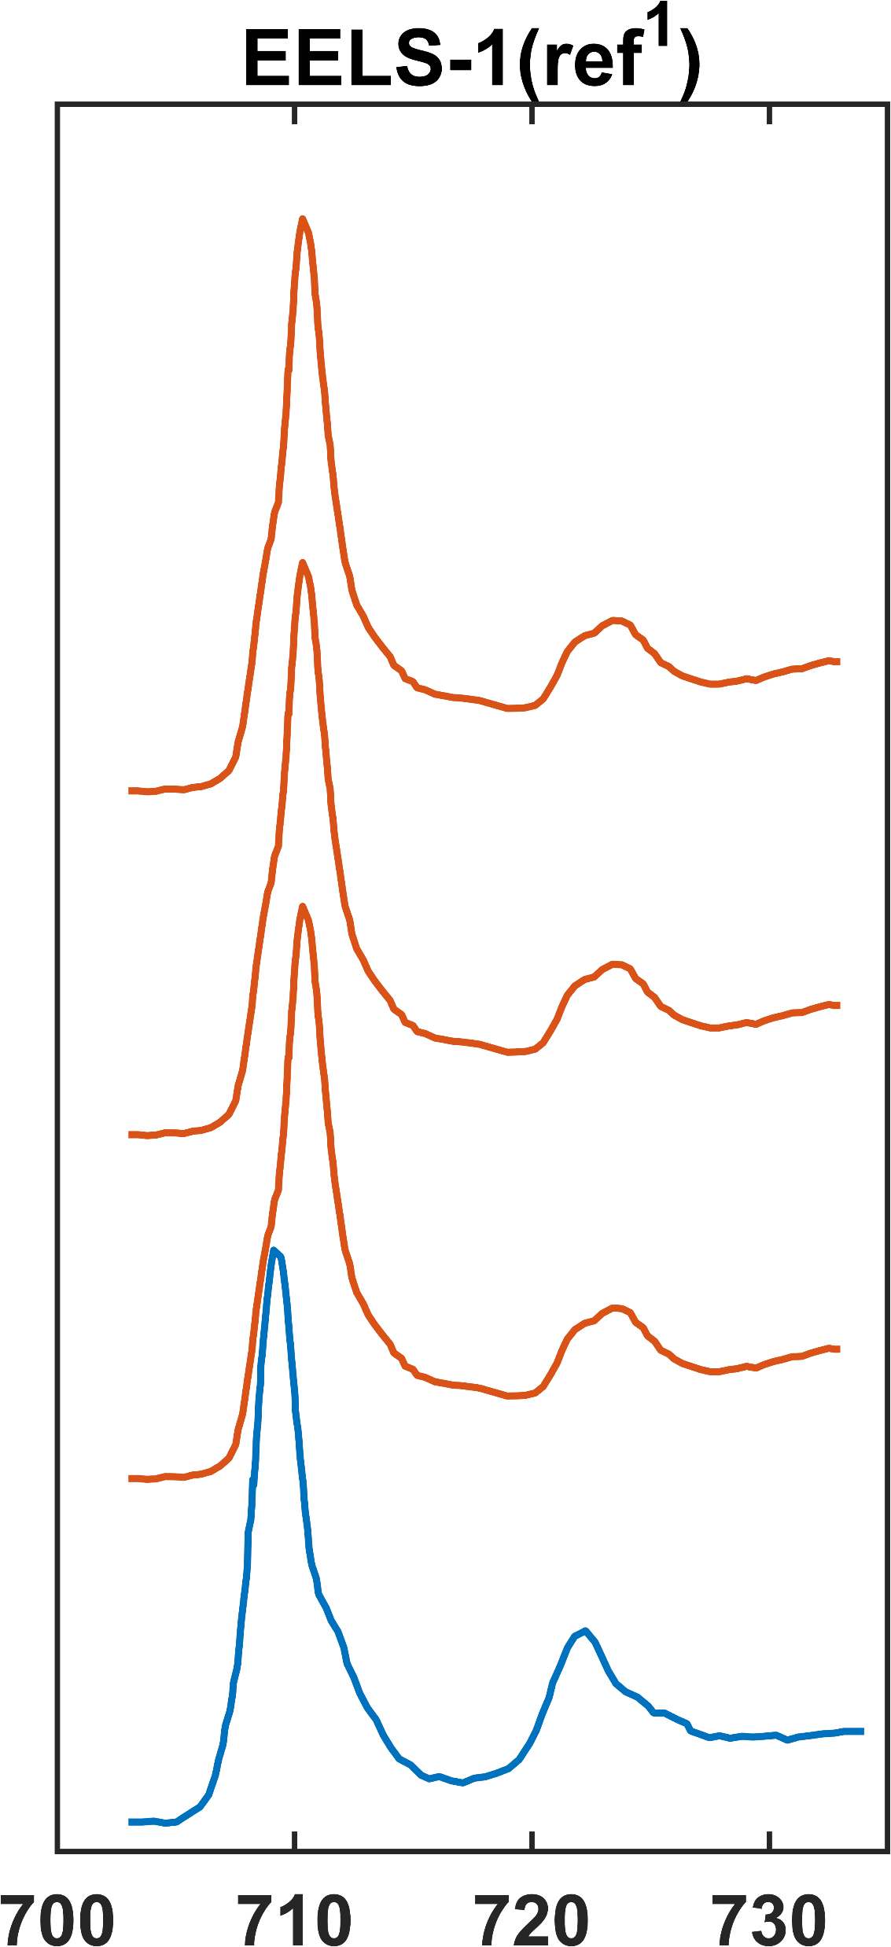
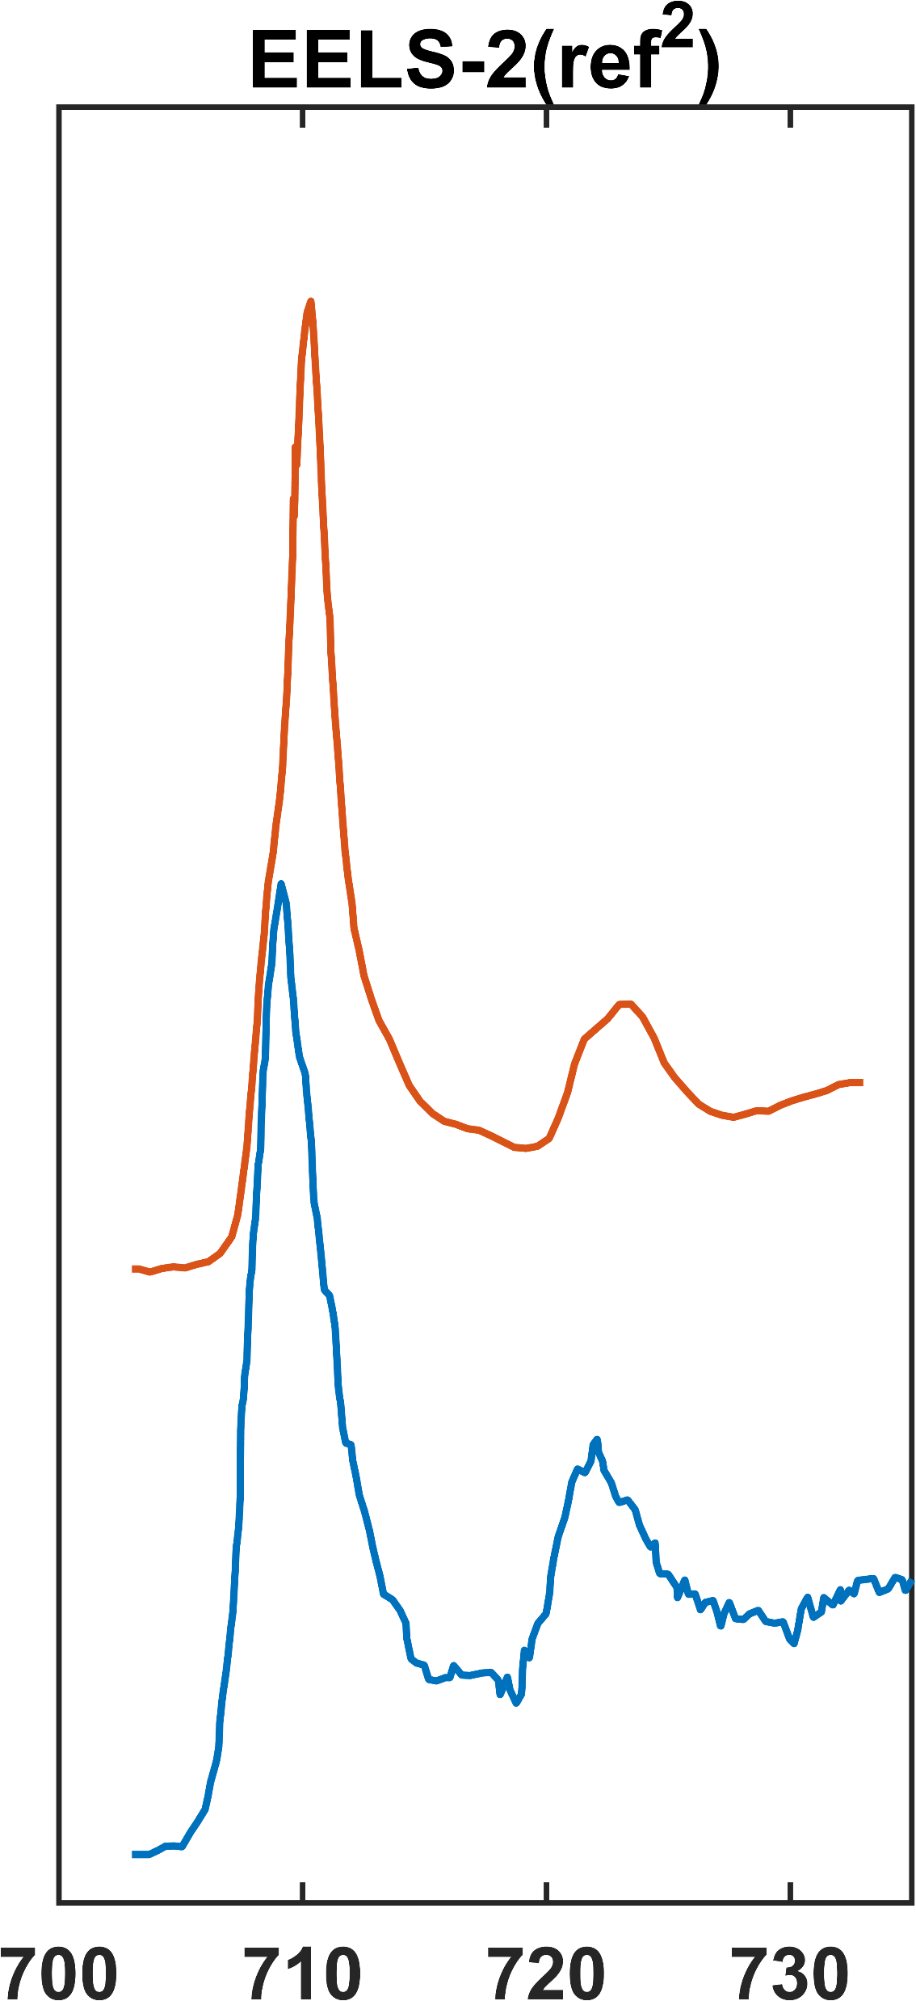
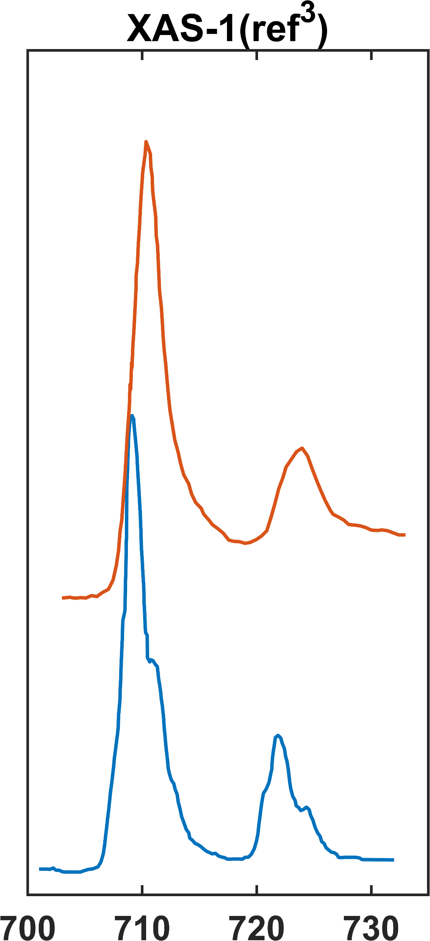
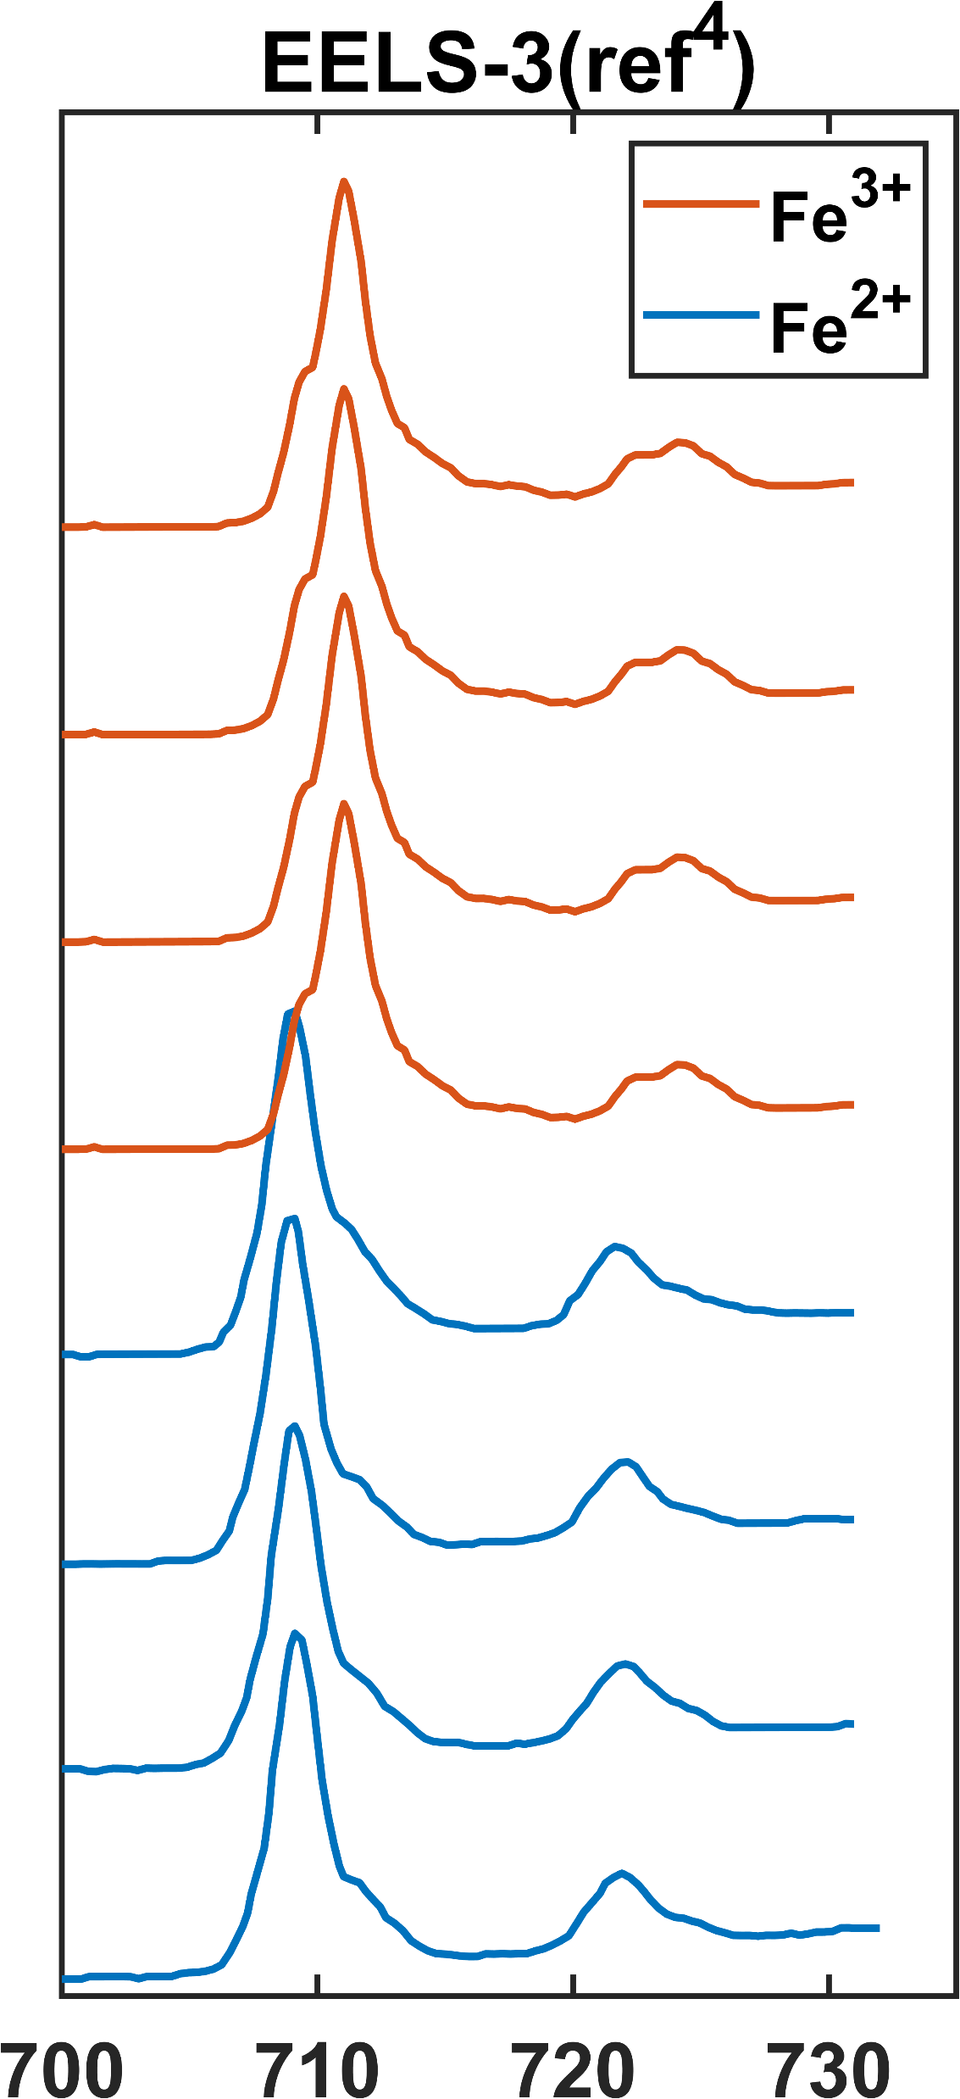
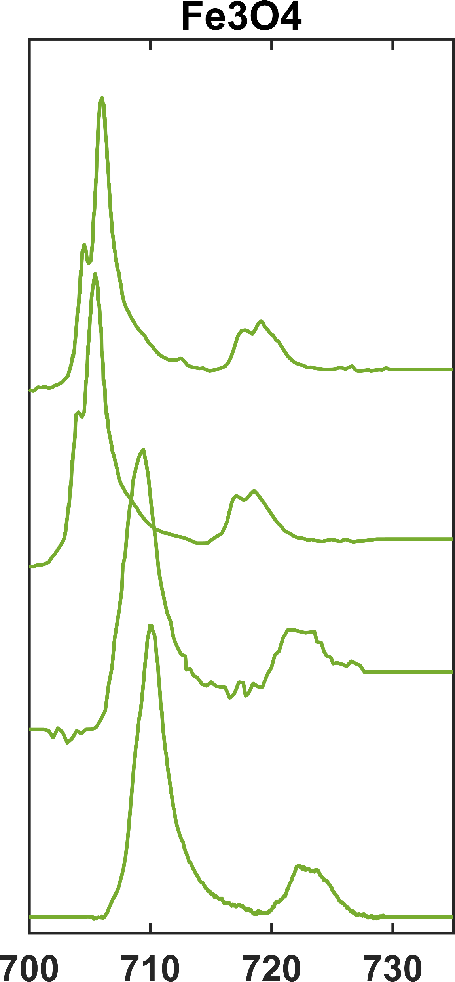
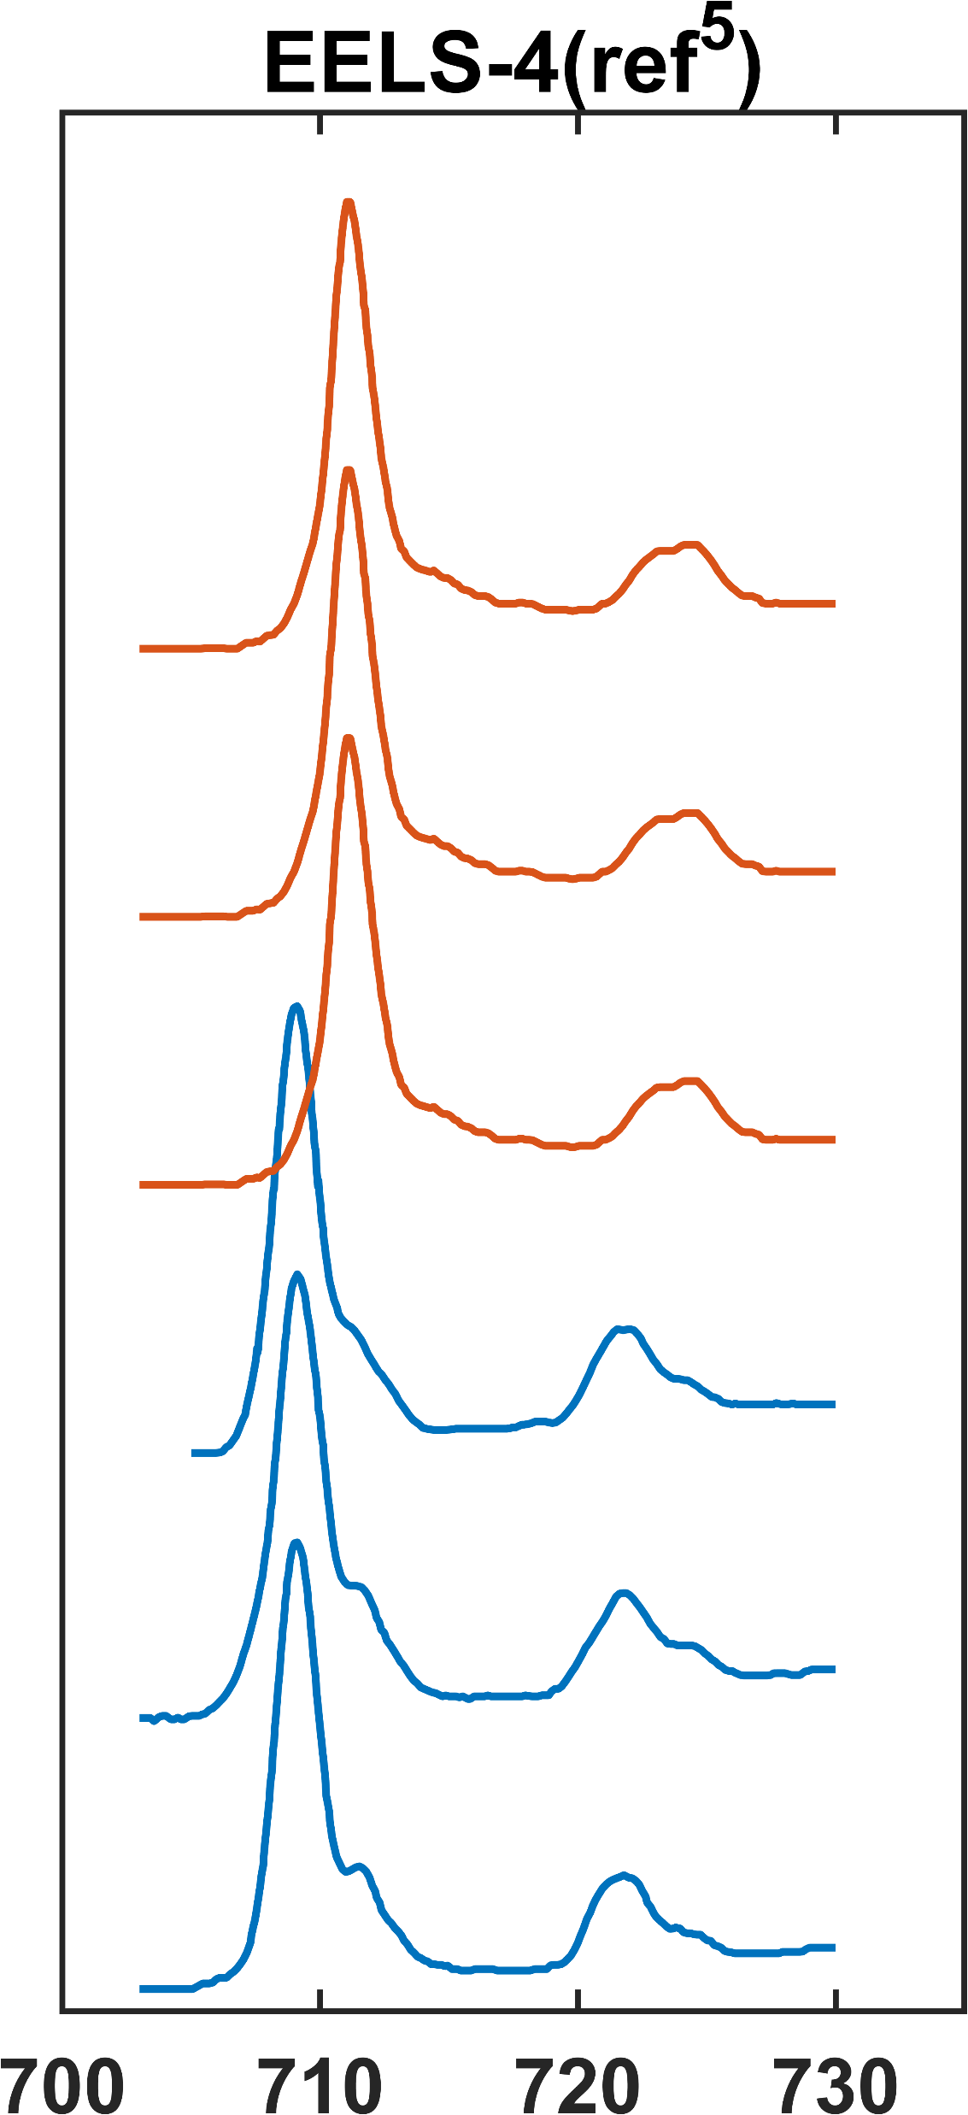
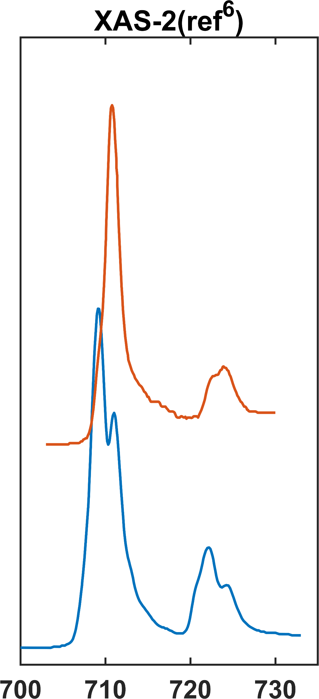
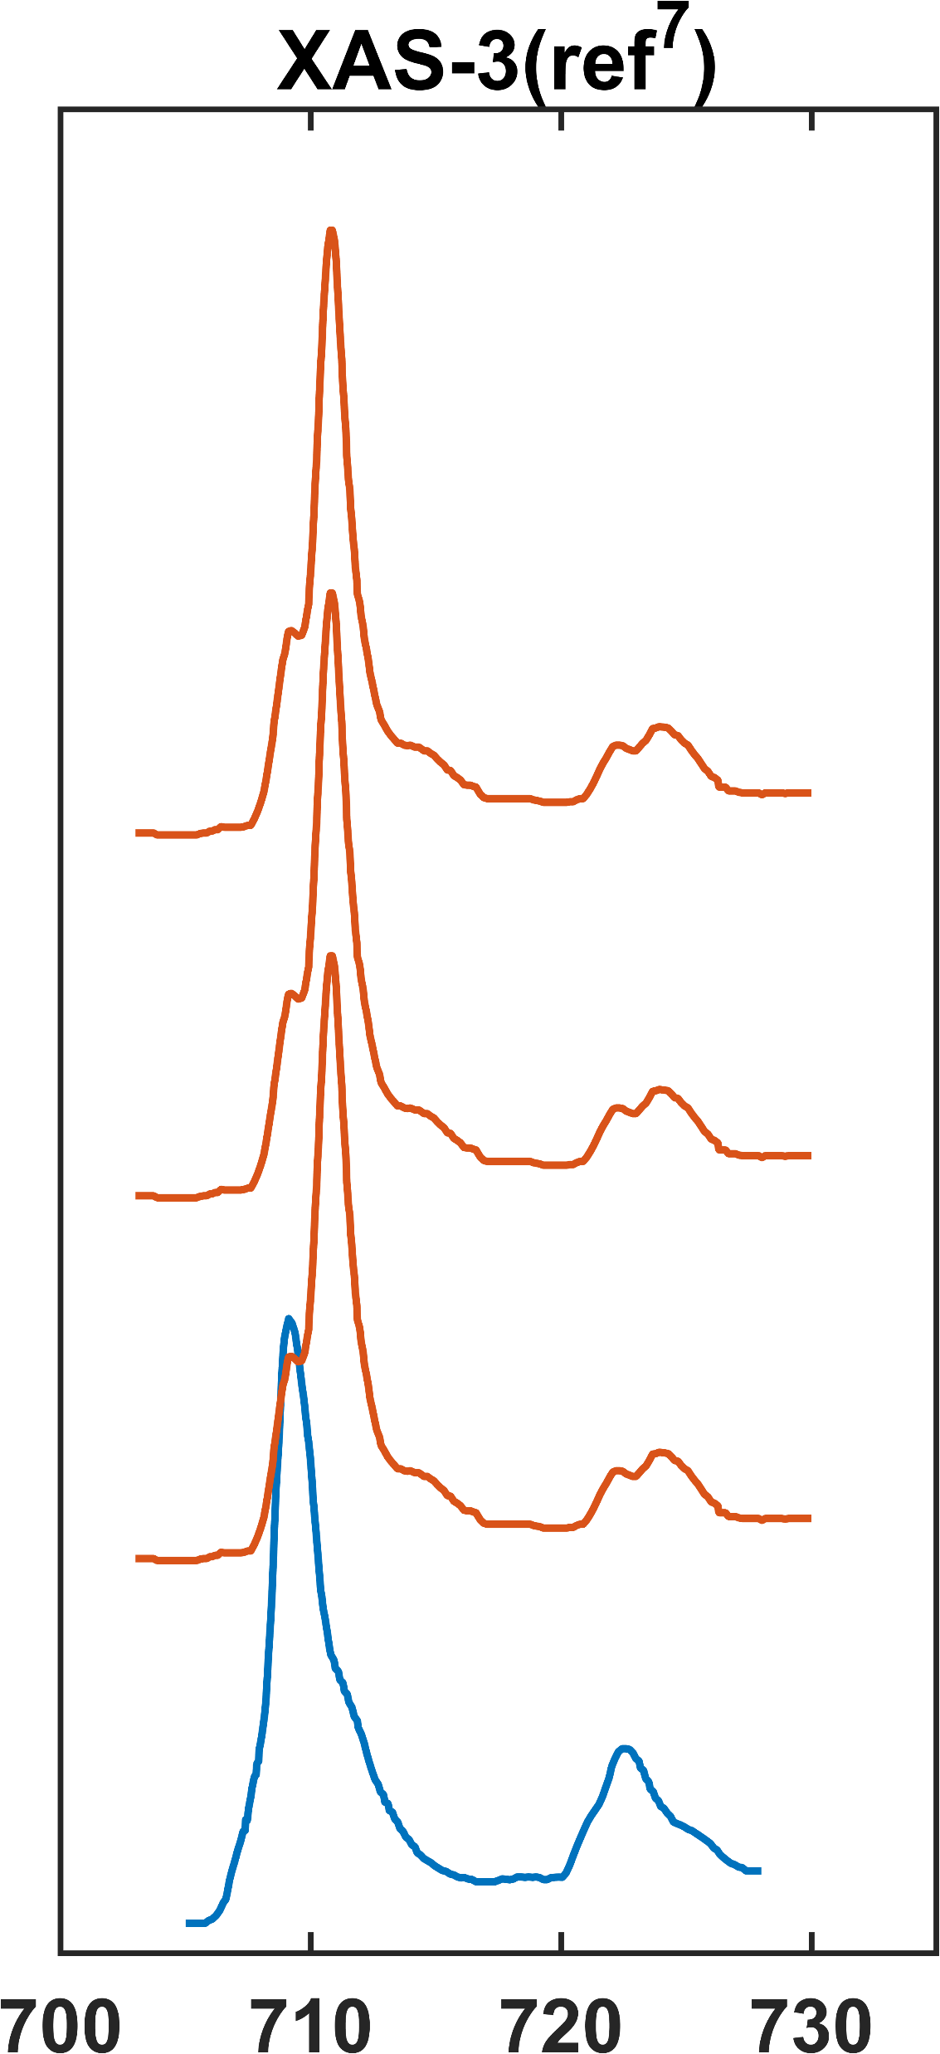
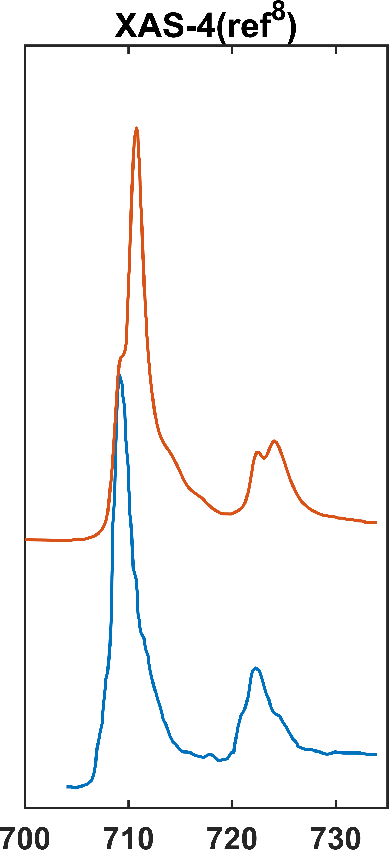
Intensity (a.u.)
Energy Loss/Photon Energy (eV)

Slide 2
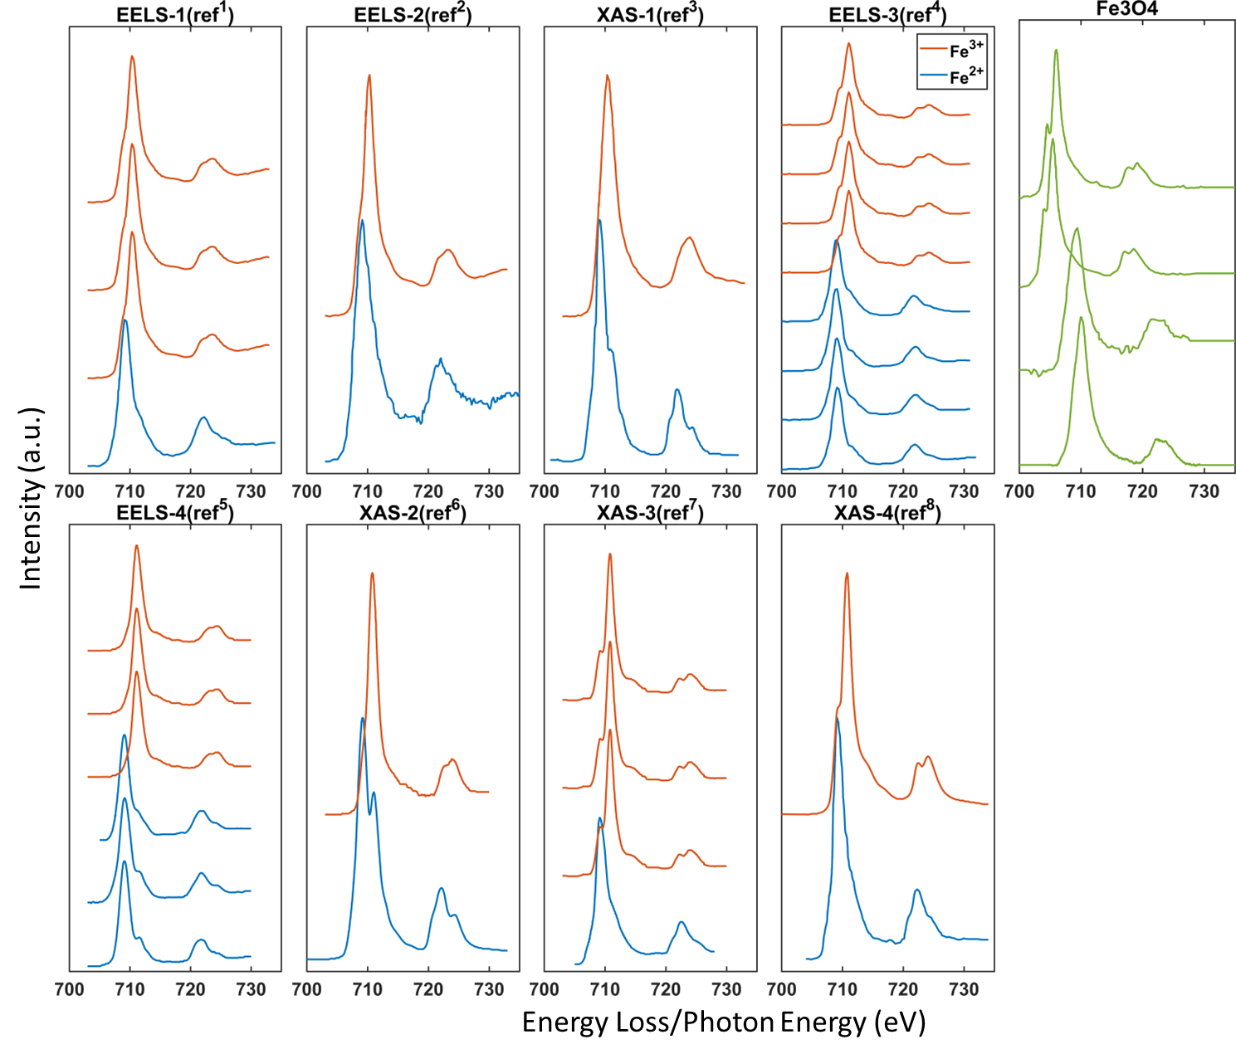

Slide 3
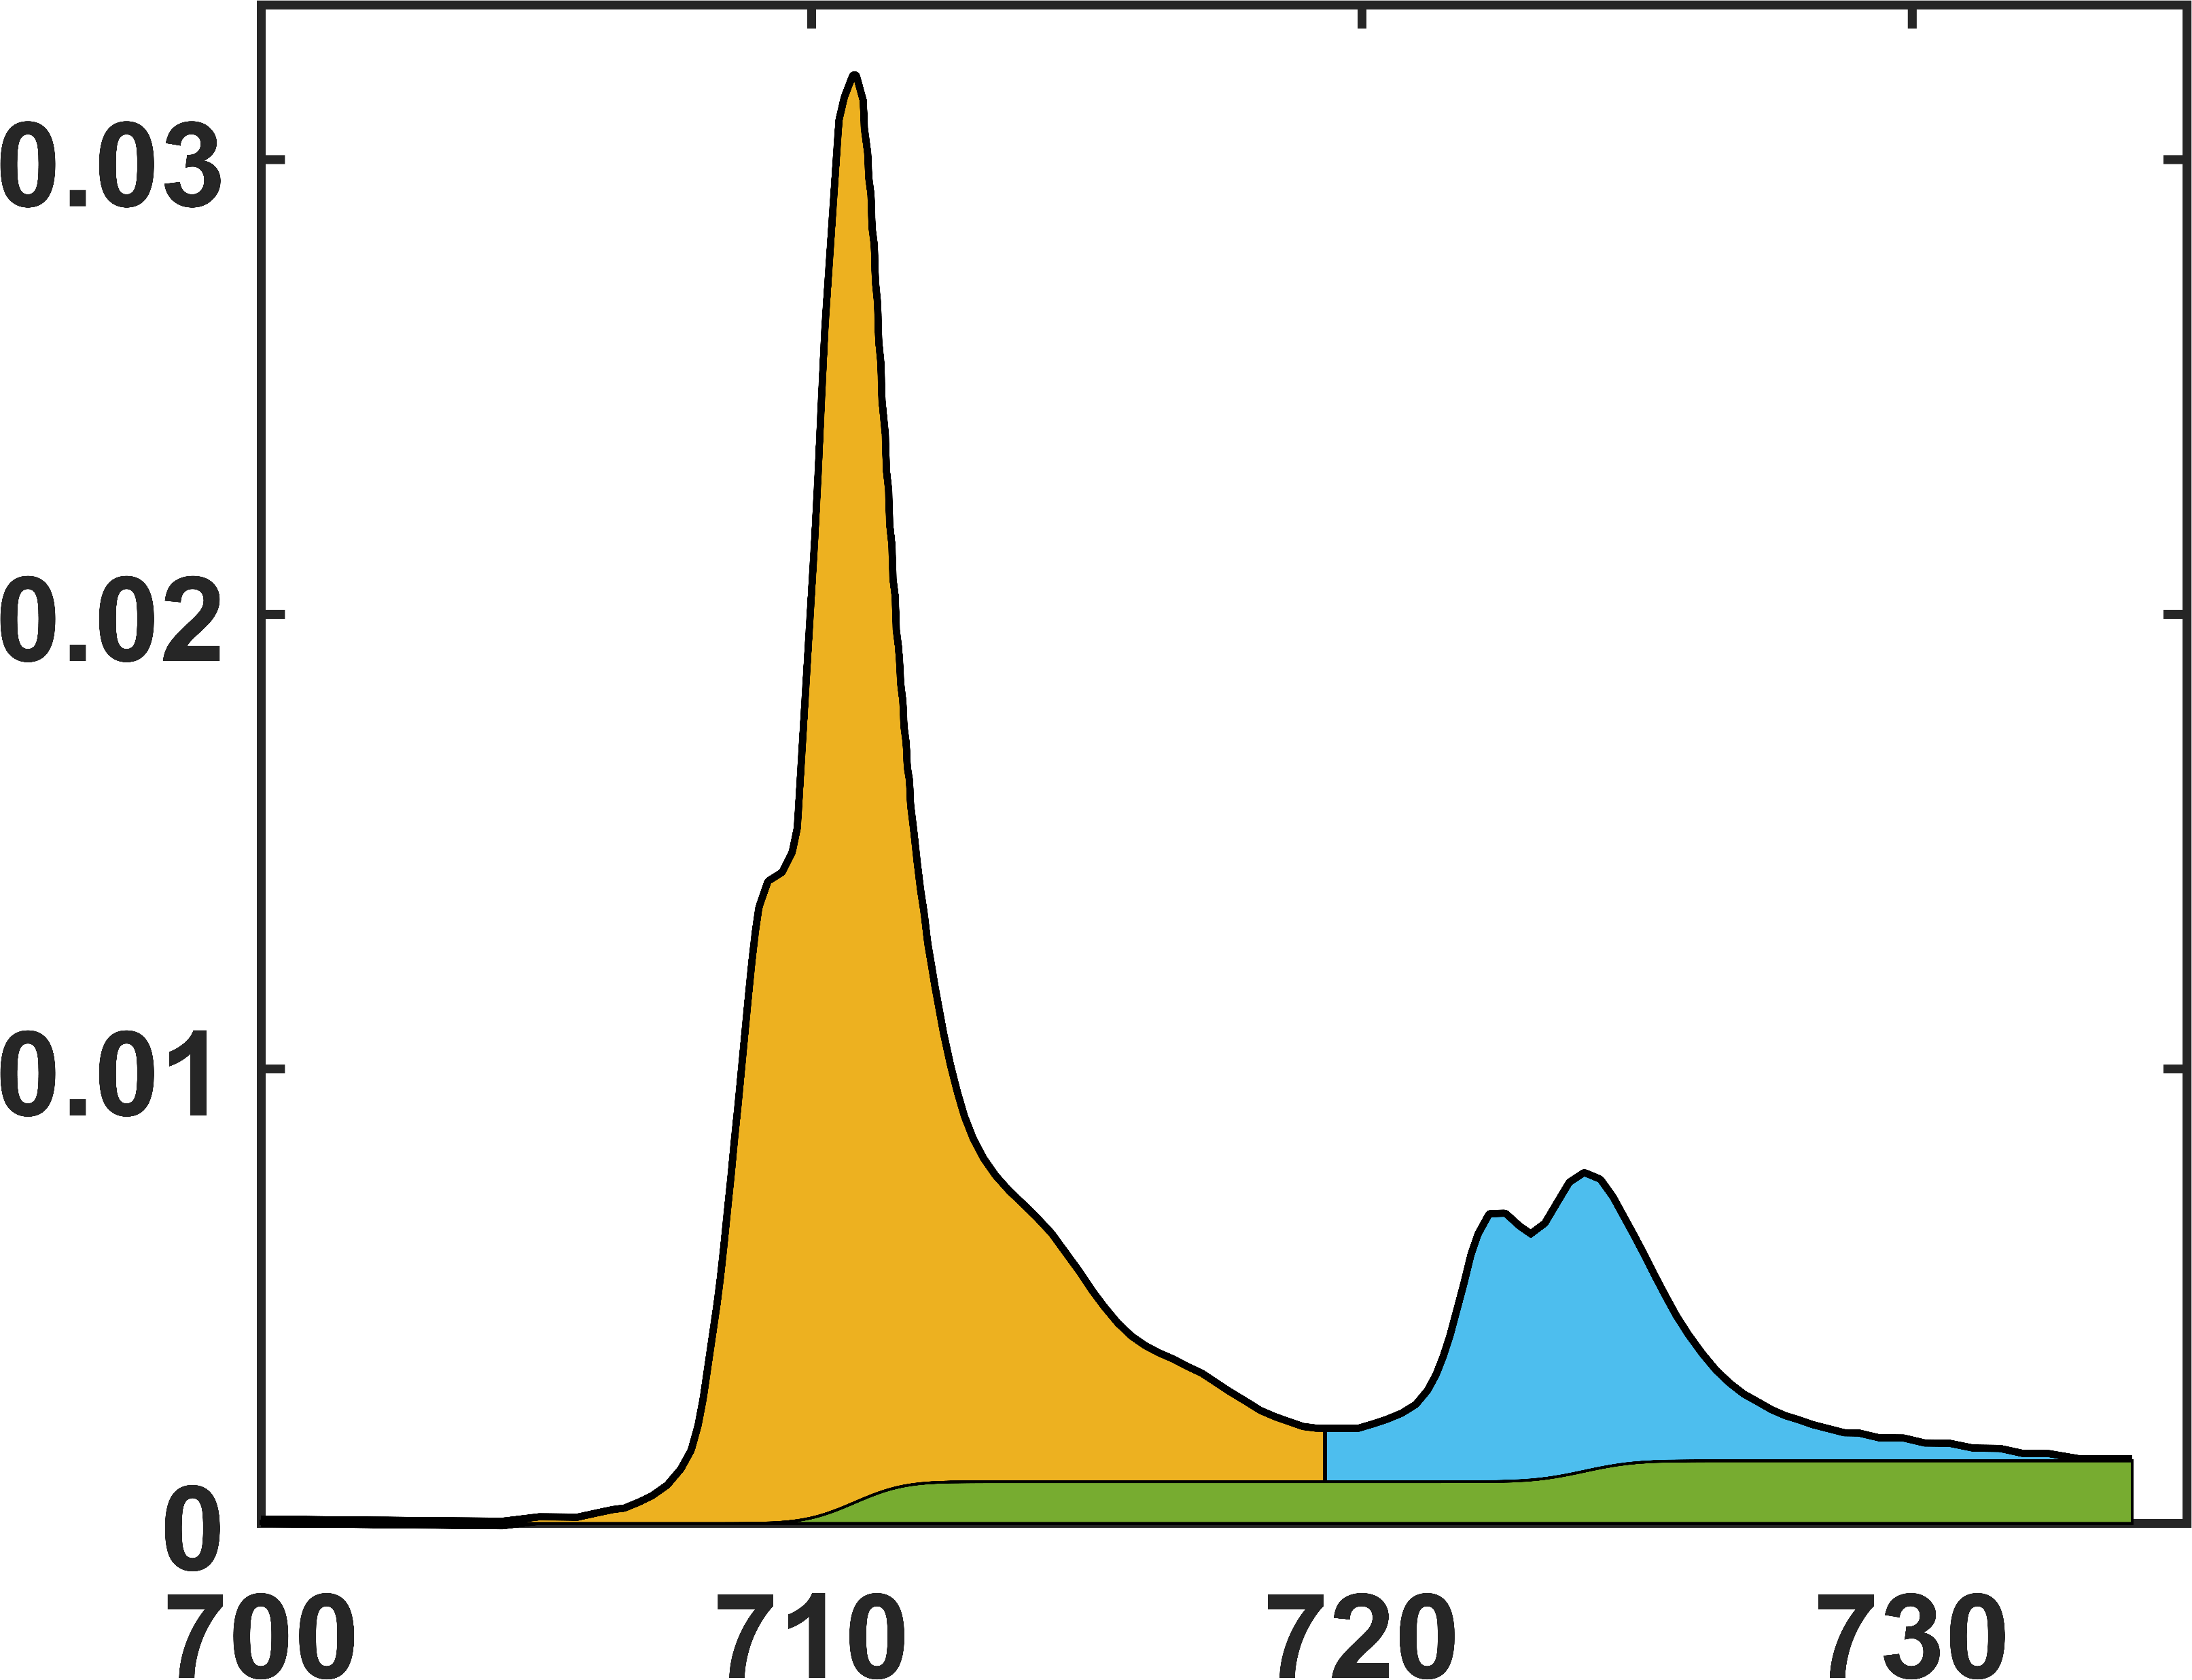
L3
Area between L3 edge and two-step function tracks the d hole number
Intensity (a.u.)
two-step function
L2
Energy Loss (eV)

Slide 4
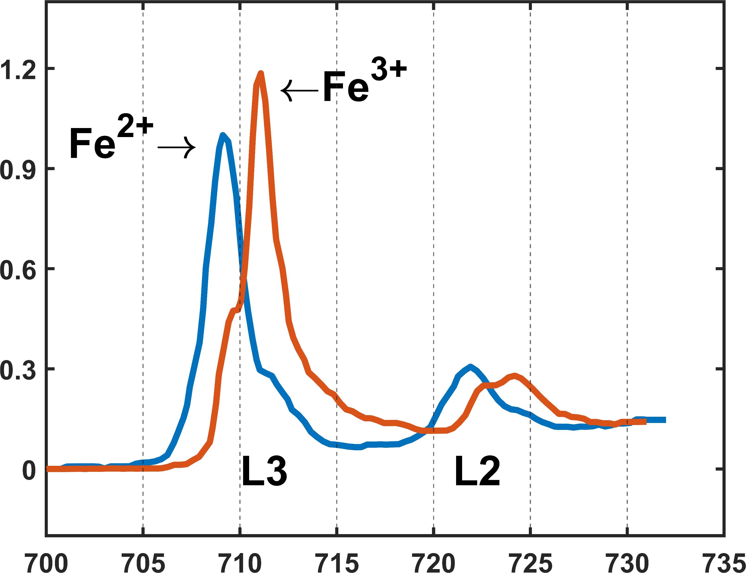
Intensity (a.u.)
Energy Loss (eV)

Slide 5
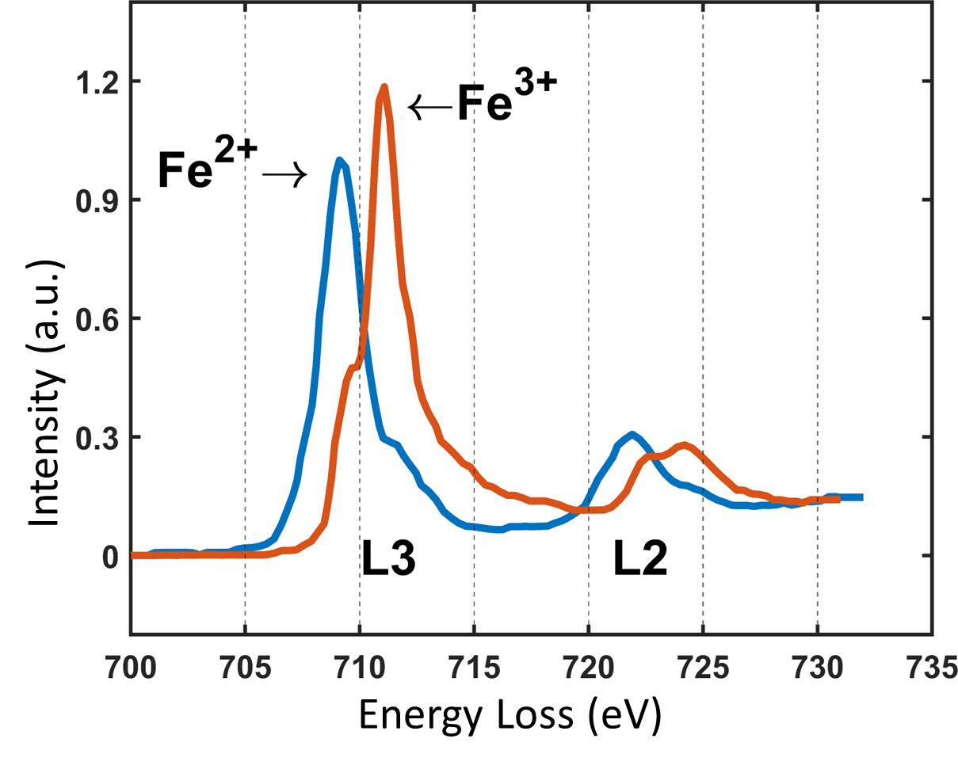
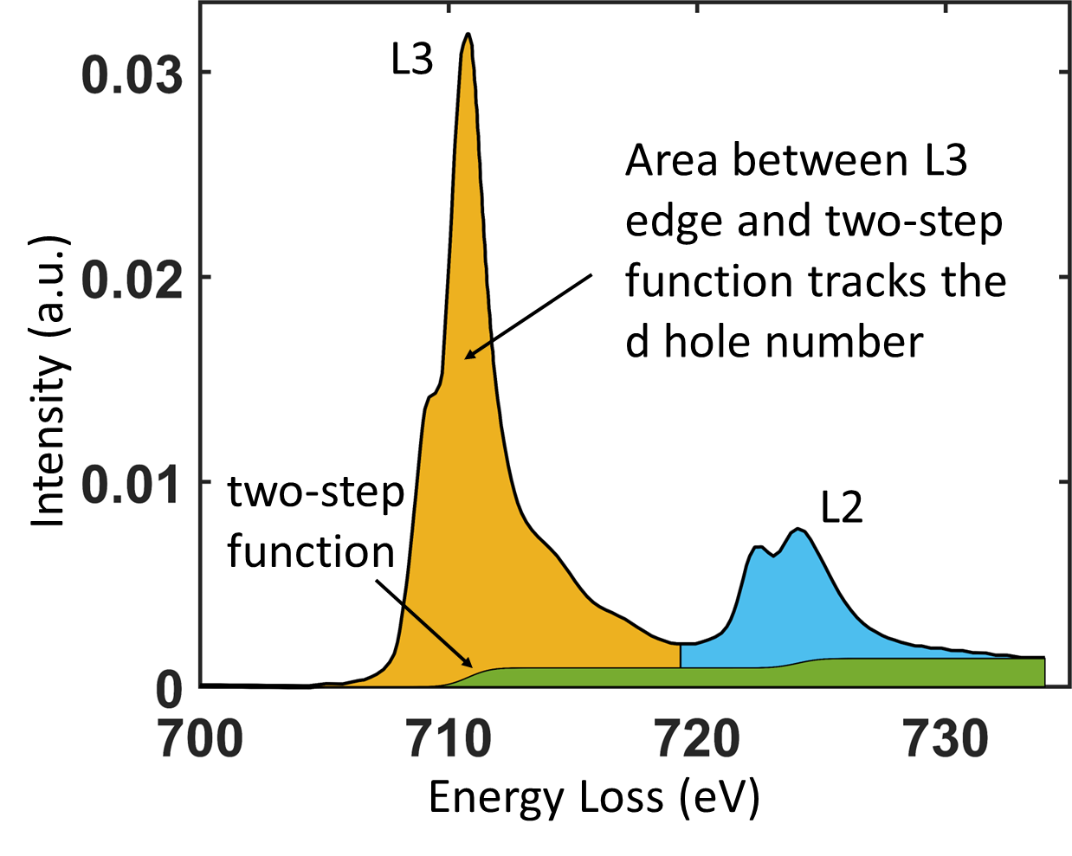

Slide 6
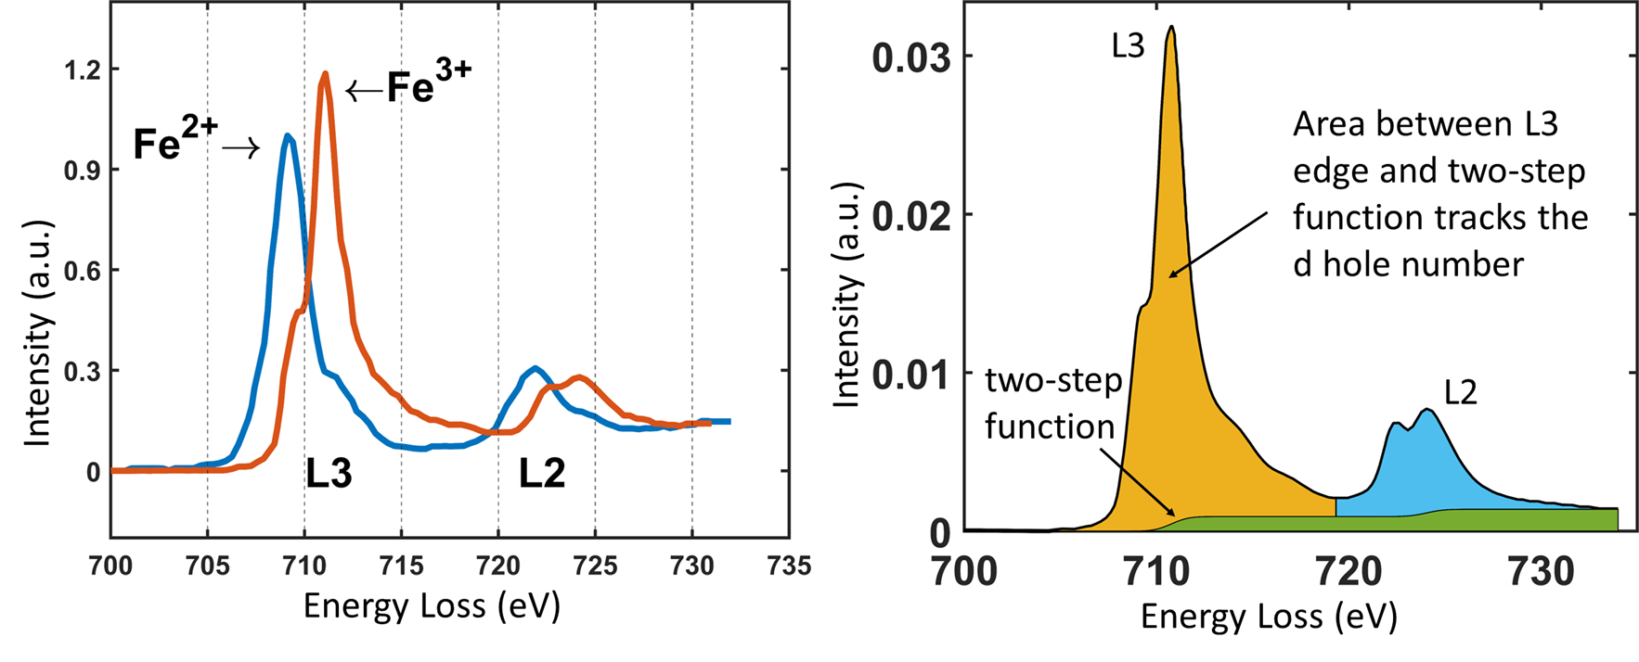

Slide 7
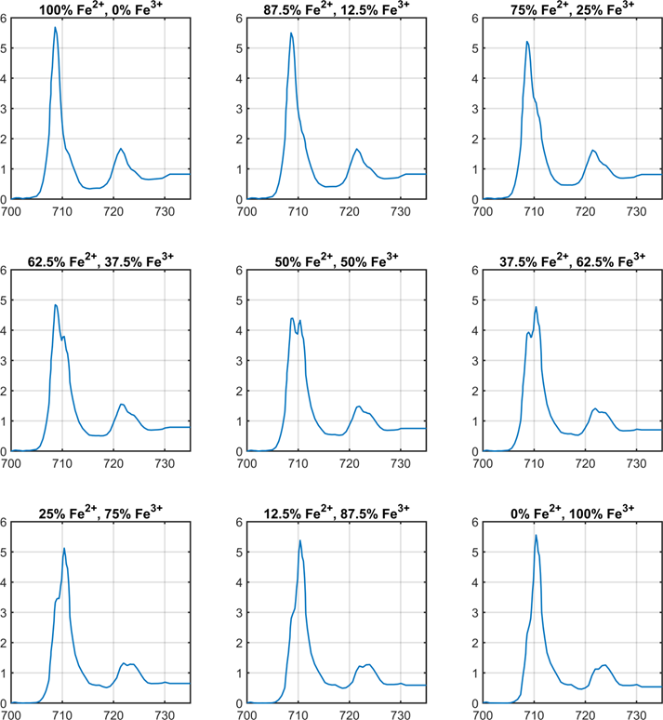
Intensity (a.u.)
Energy Loss (eV)

Slide 8
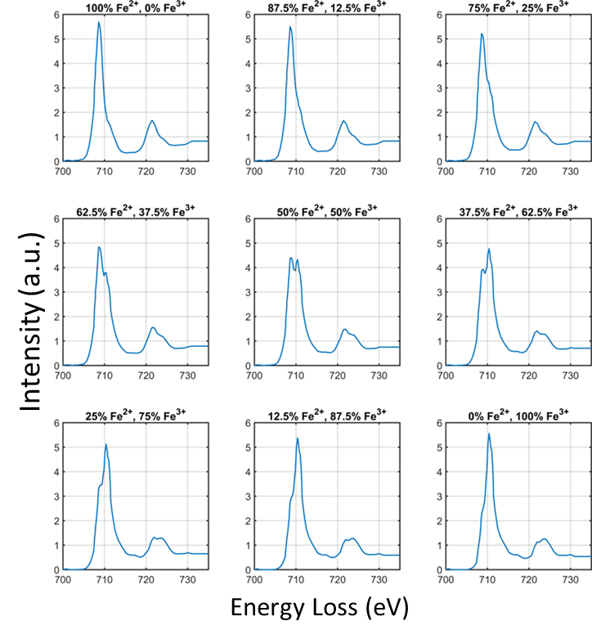

Slide 9
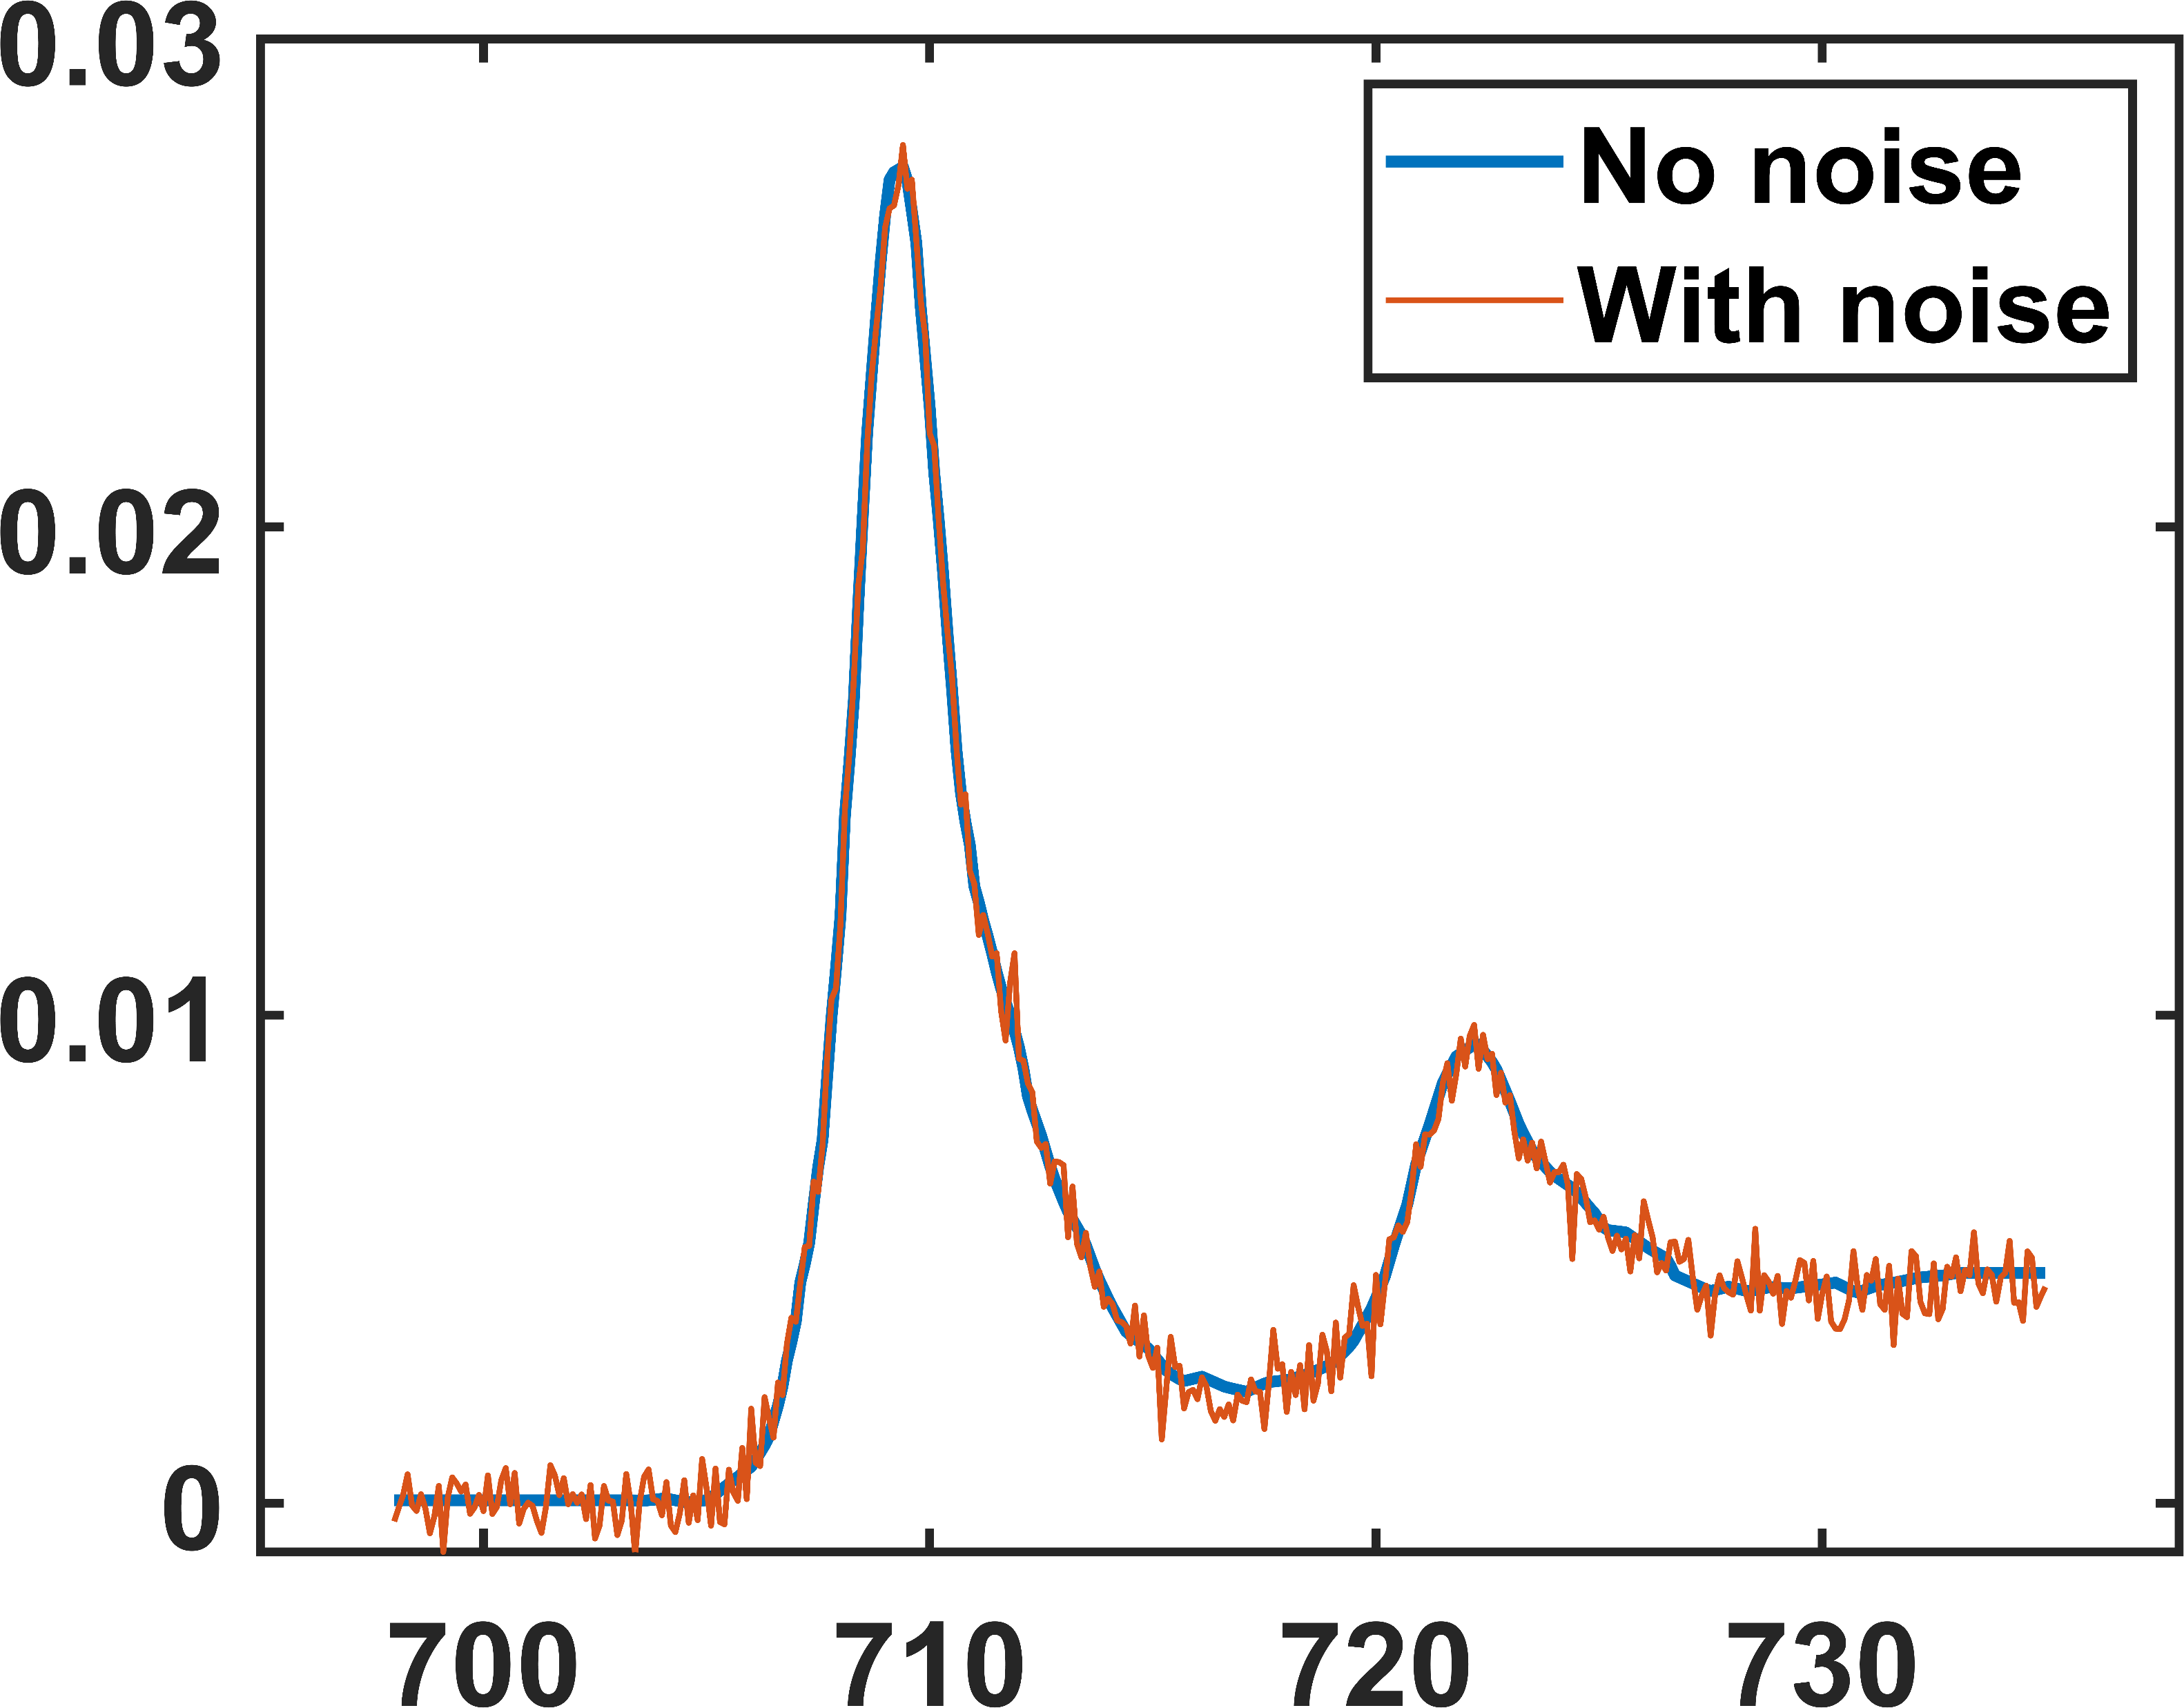
Intensity (a.u.)
Energy Loss (eV)

Slide 10
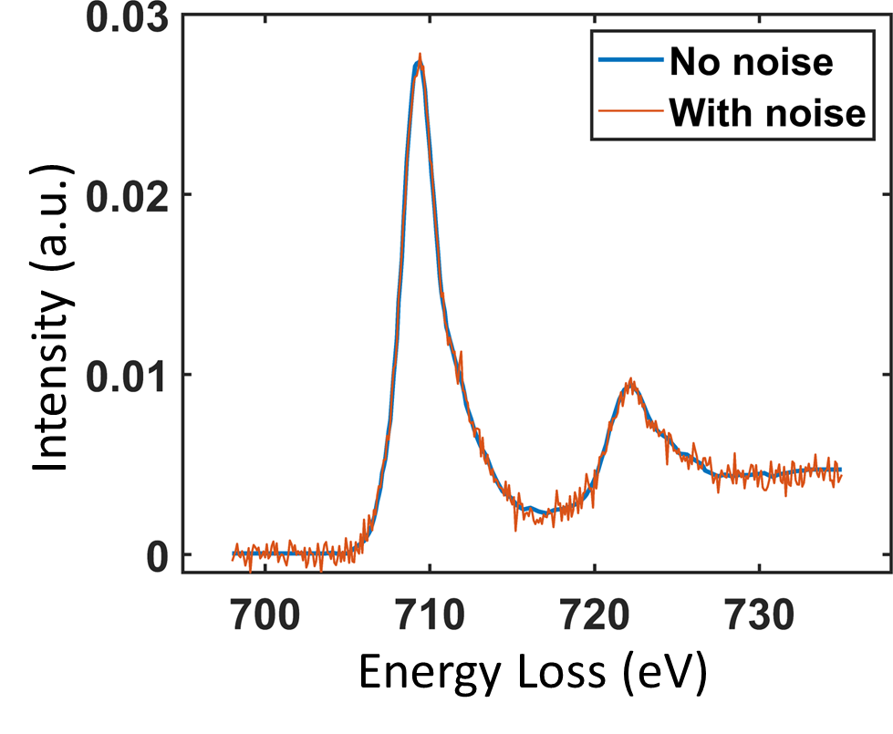

Slide 11
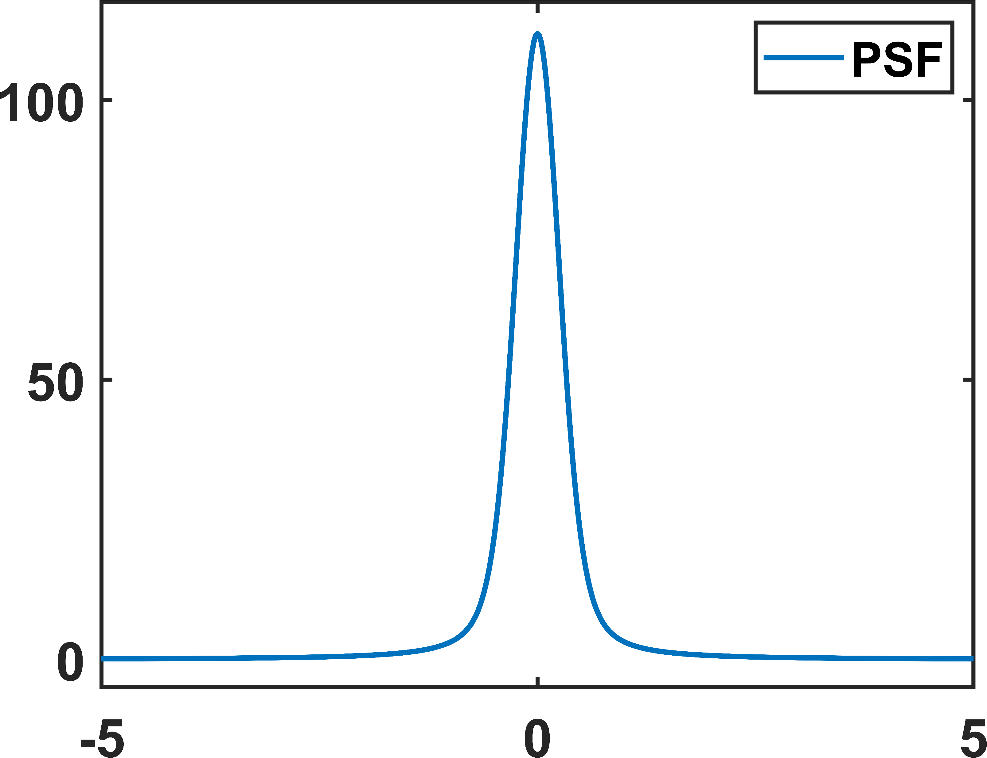
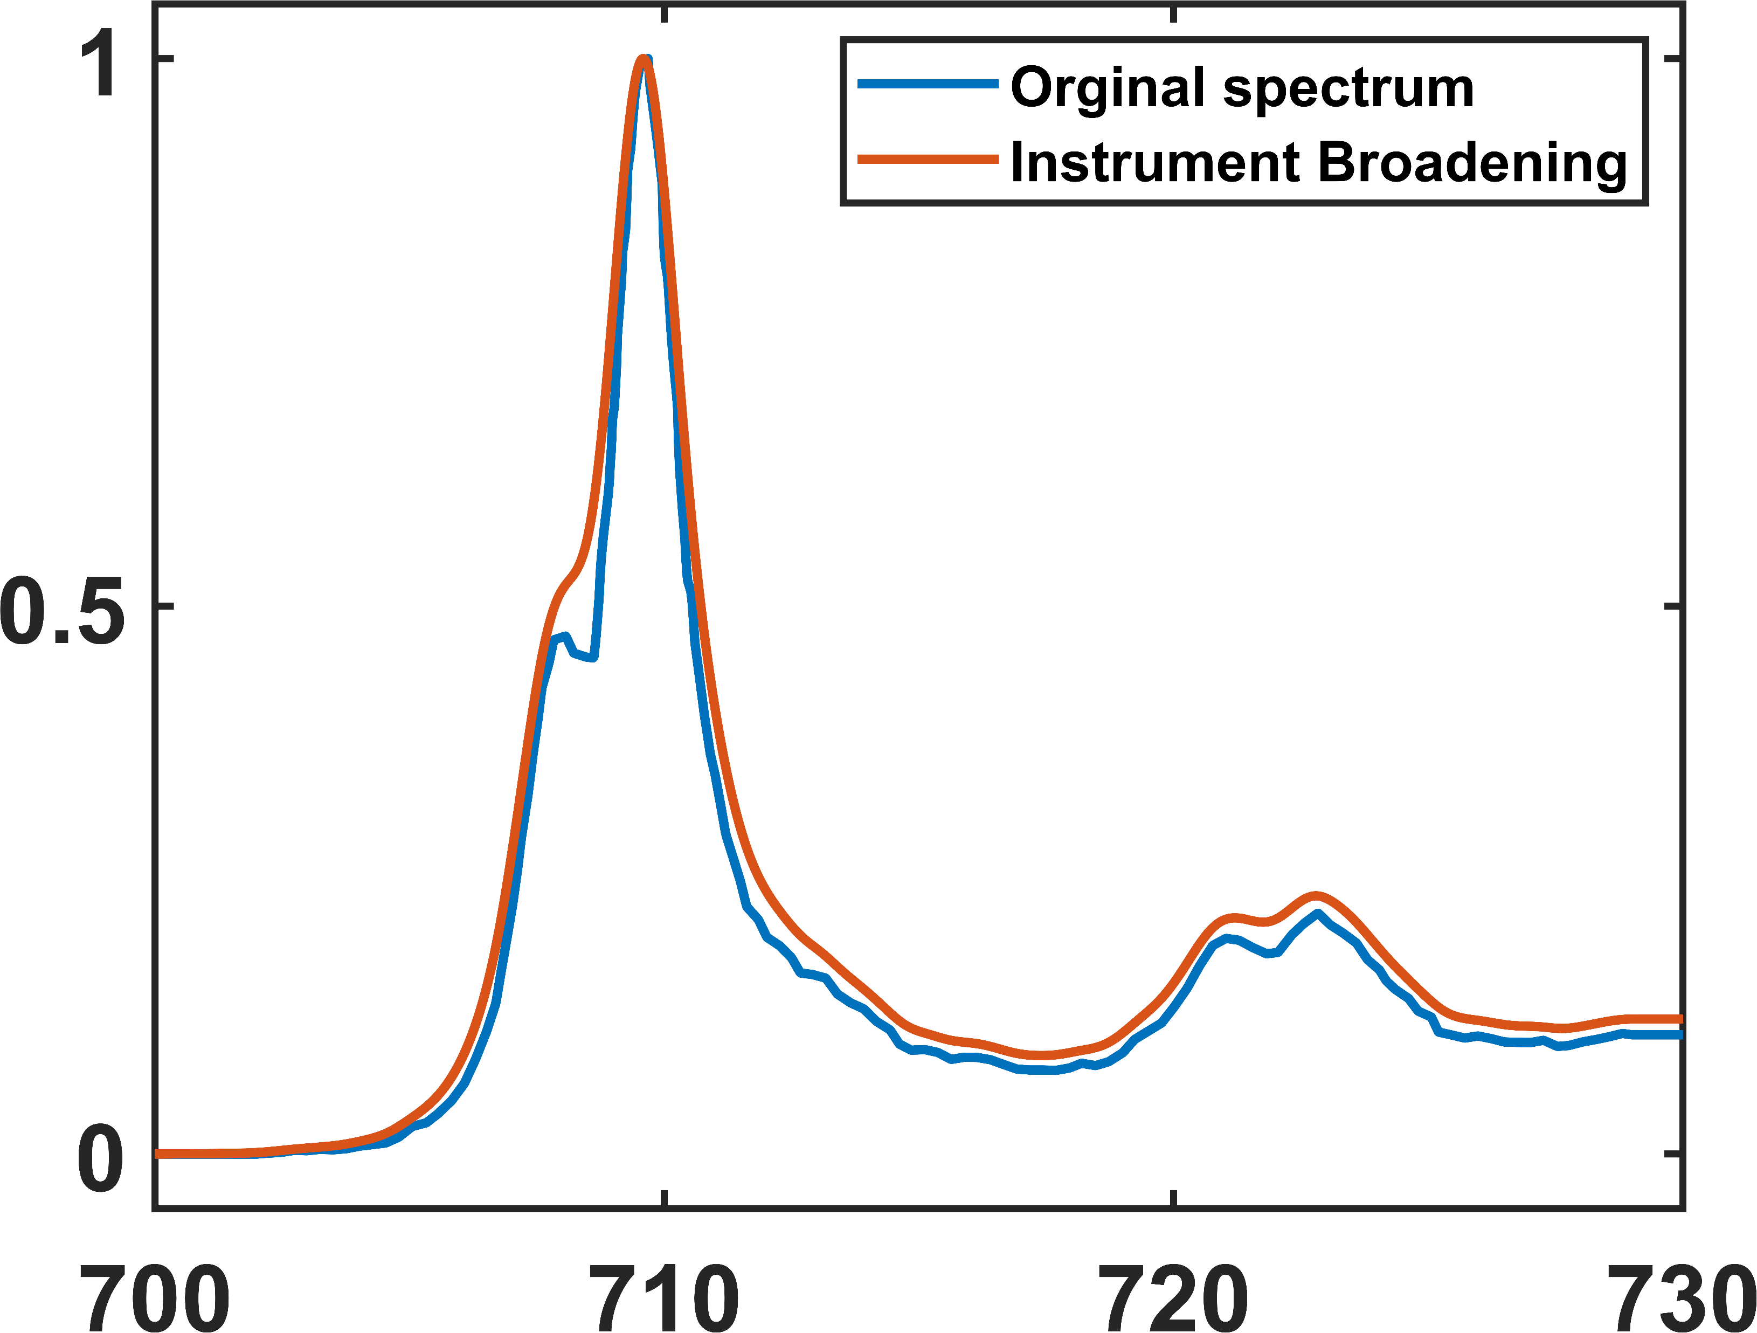
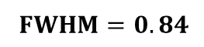
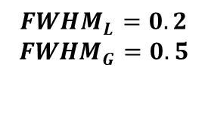
$${FWHM}_{L}=0.2$$
$${FWHM}_{G}=0.5$$
Intensity (a.u.)
$FWHM=0.84$
Energy Loss (eV)

Slide 12
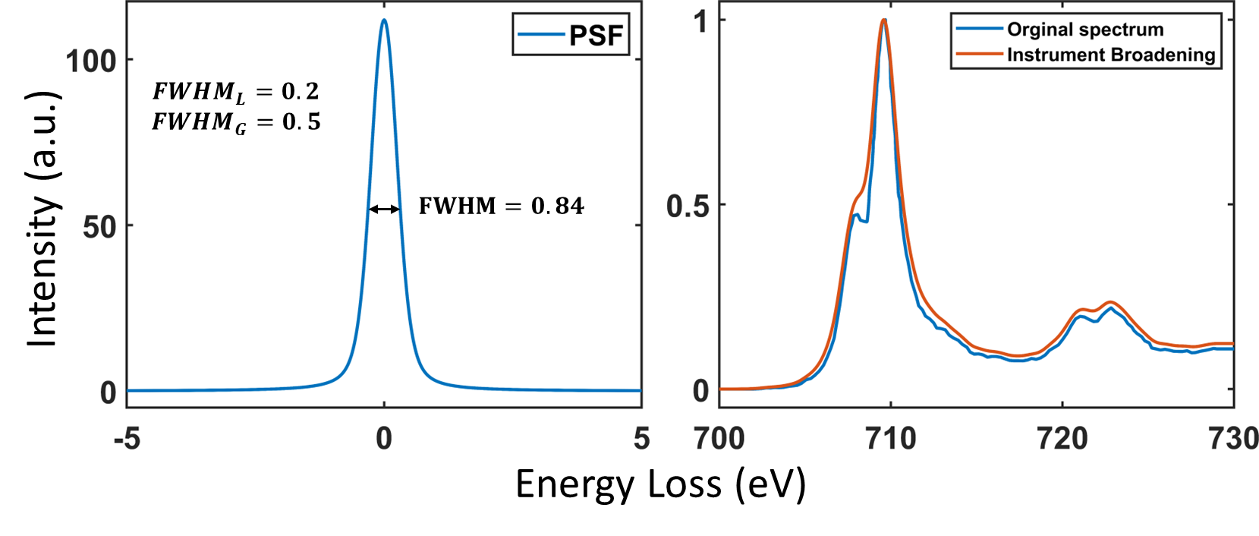

Slide 13
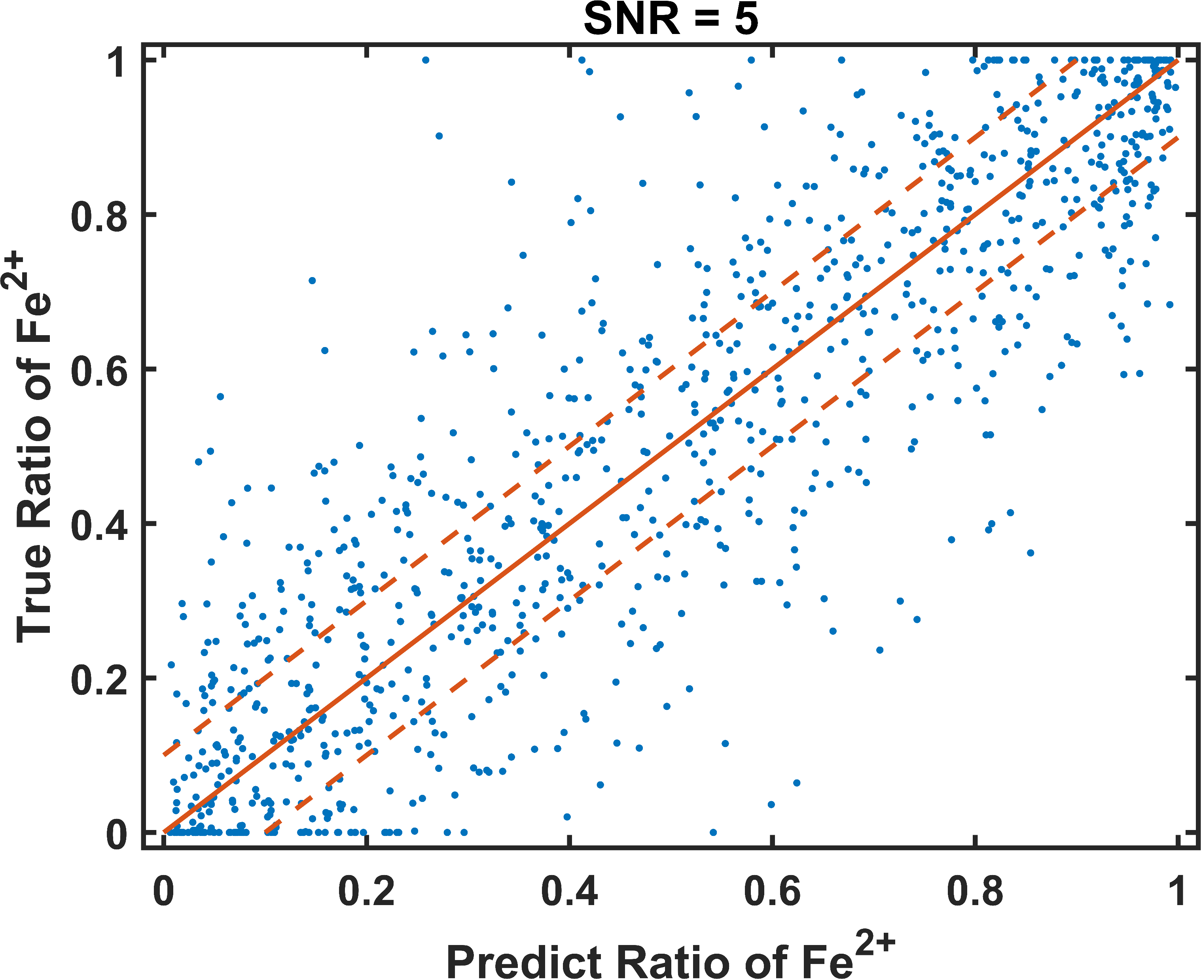
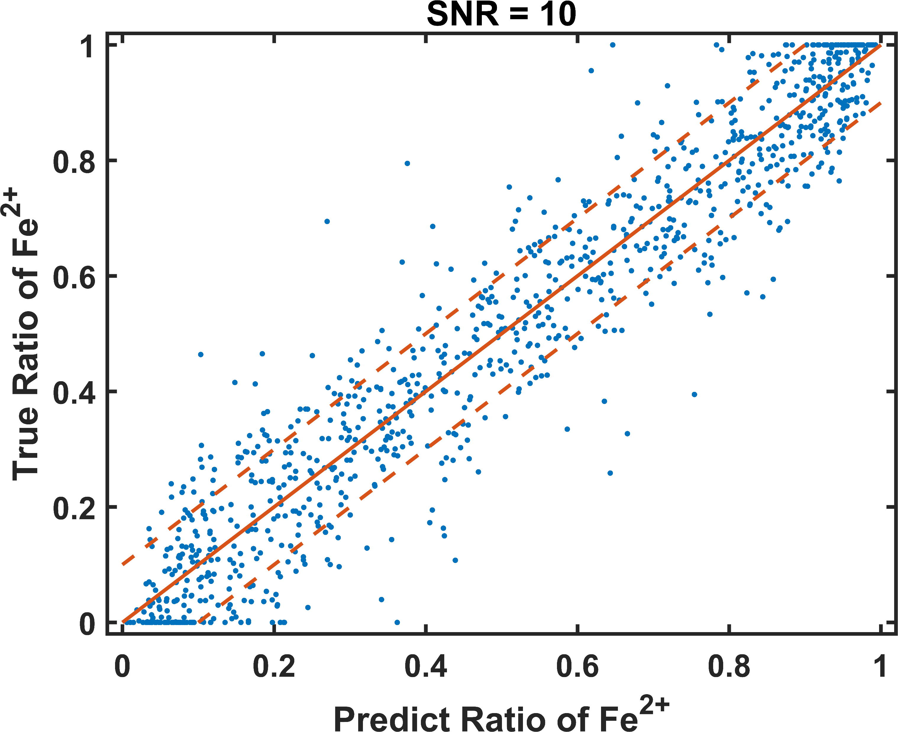

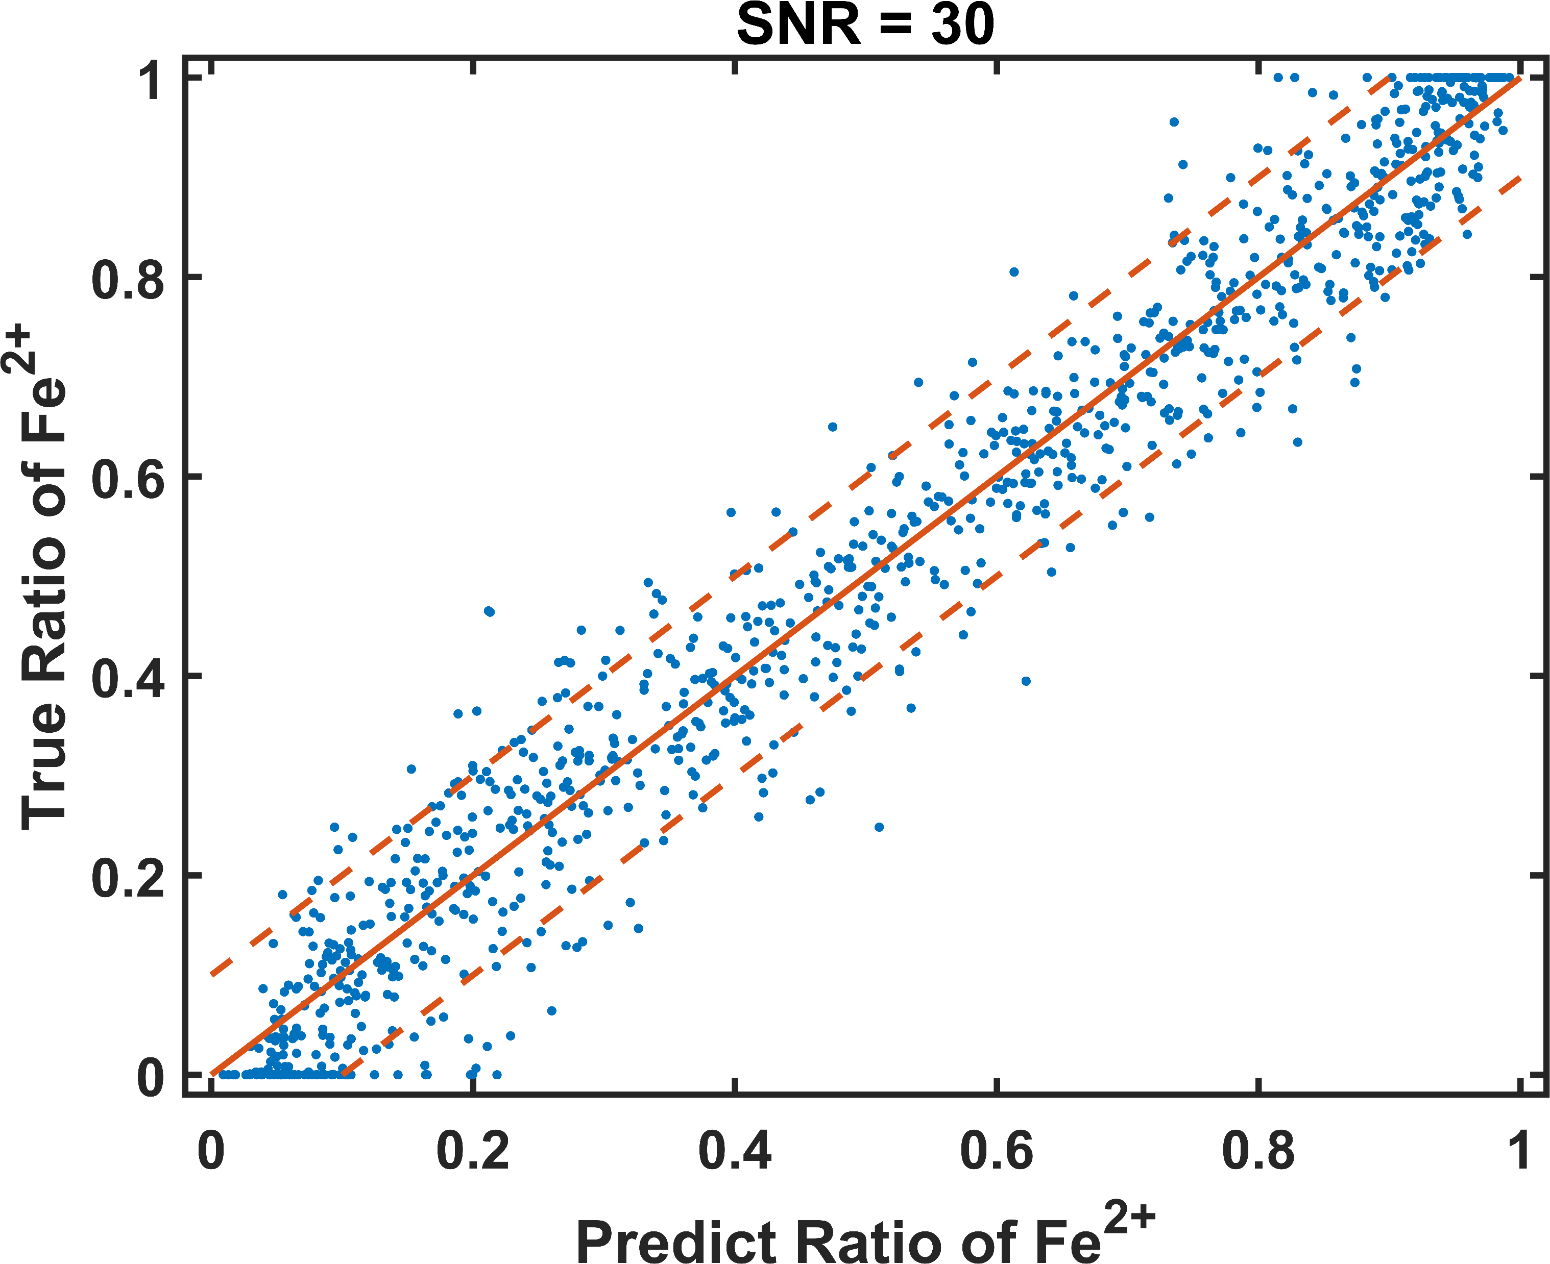
Under Predict
Under Predict
Over Predict
Over Predict
Under Predict
Under Predict
Over Predict
Over Predict

Slide 14
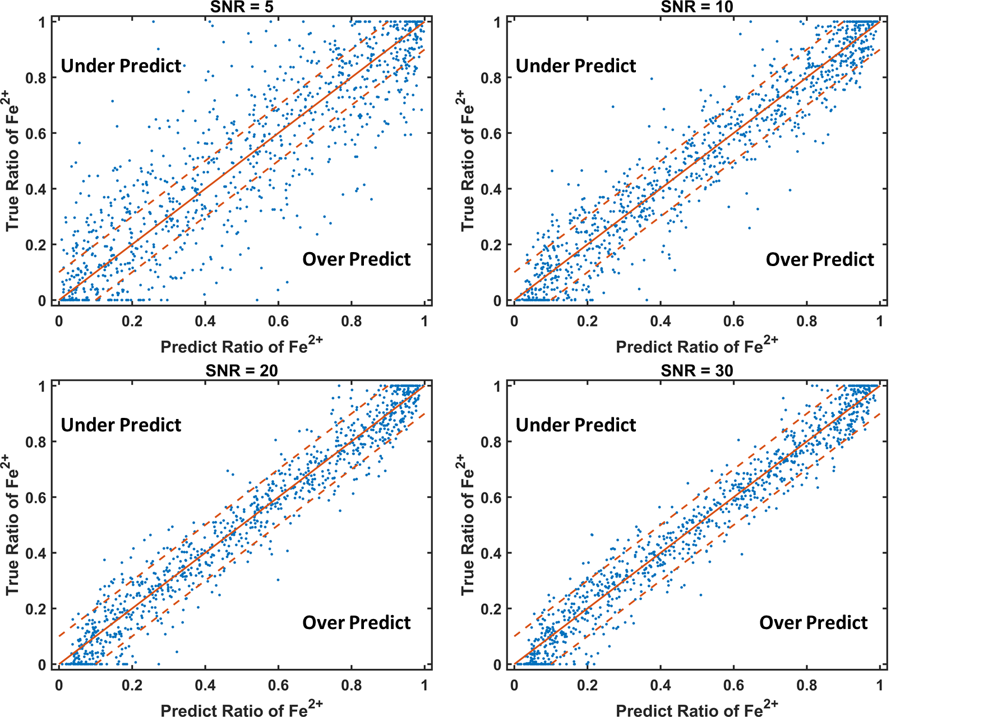

Slide 15
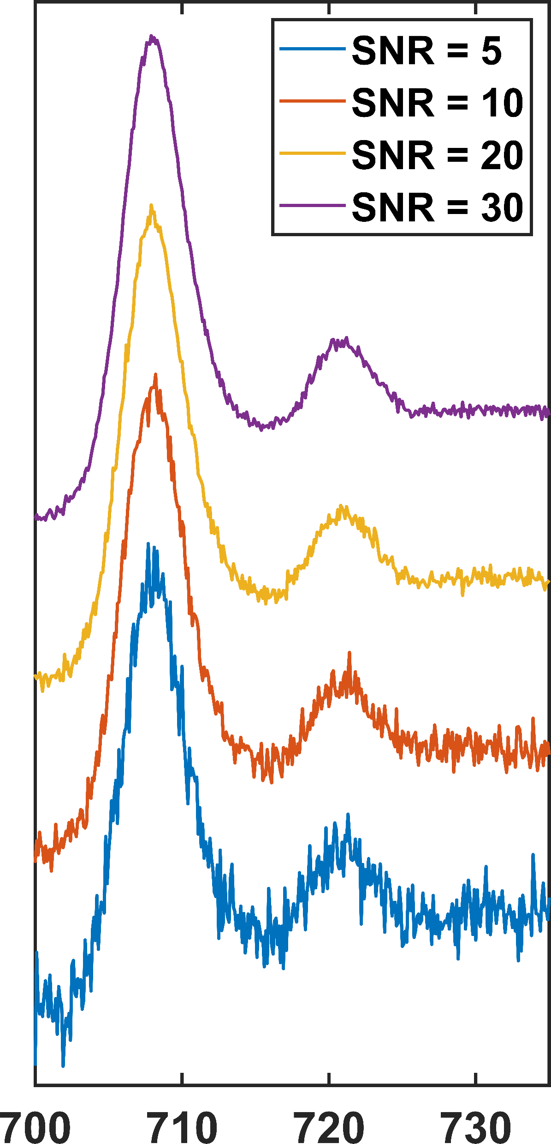
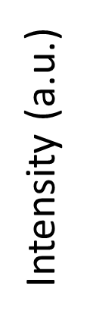
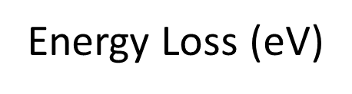

Slide 16
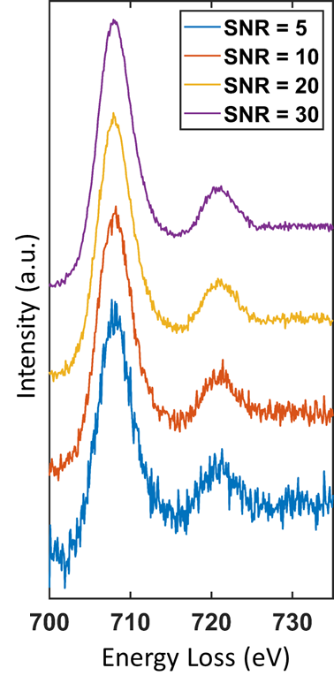

Slide 17
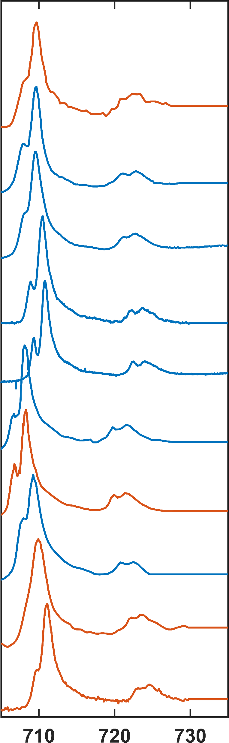
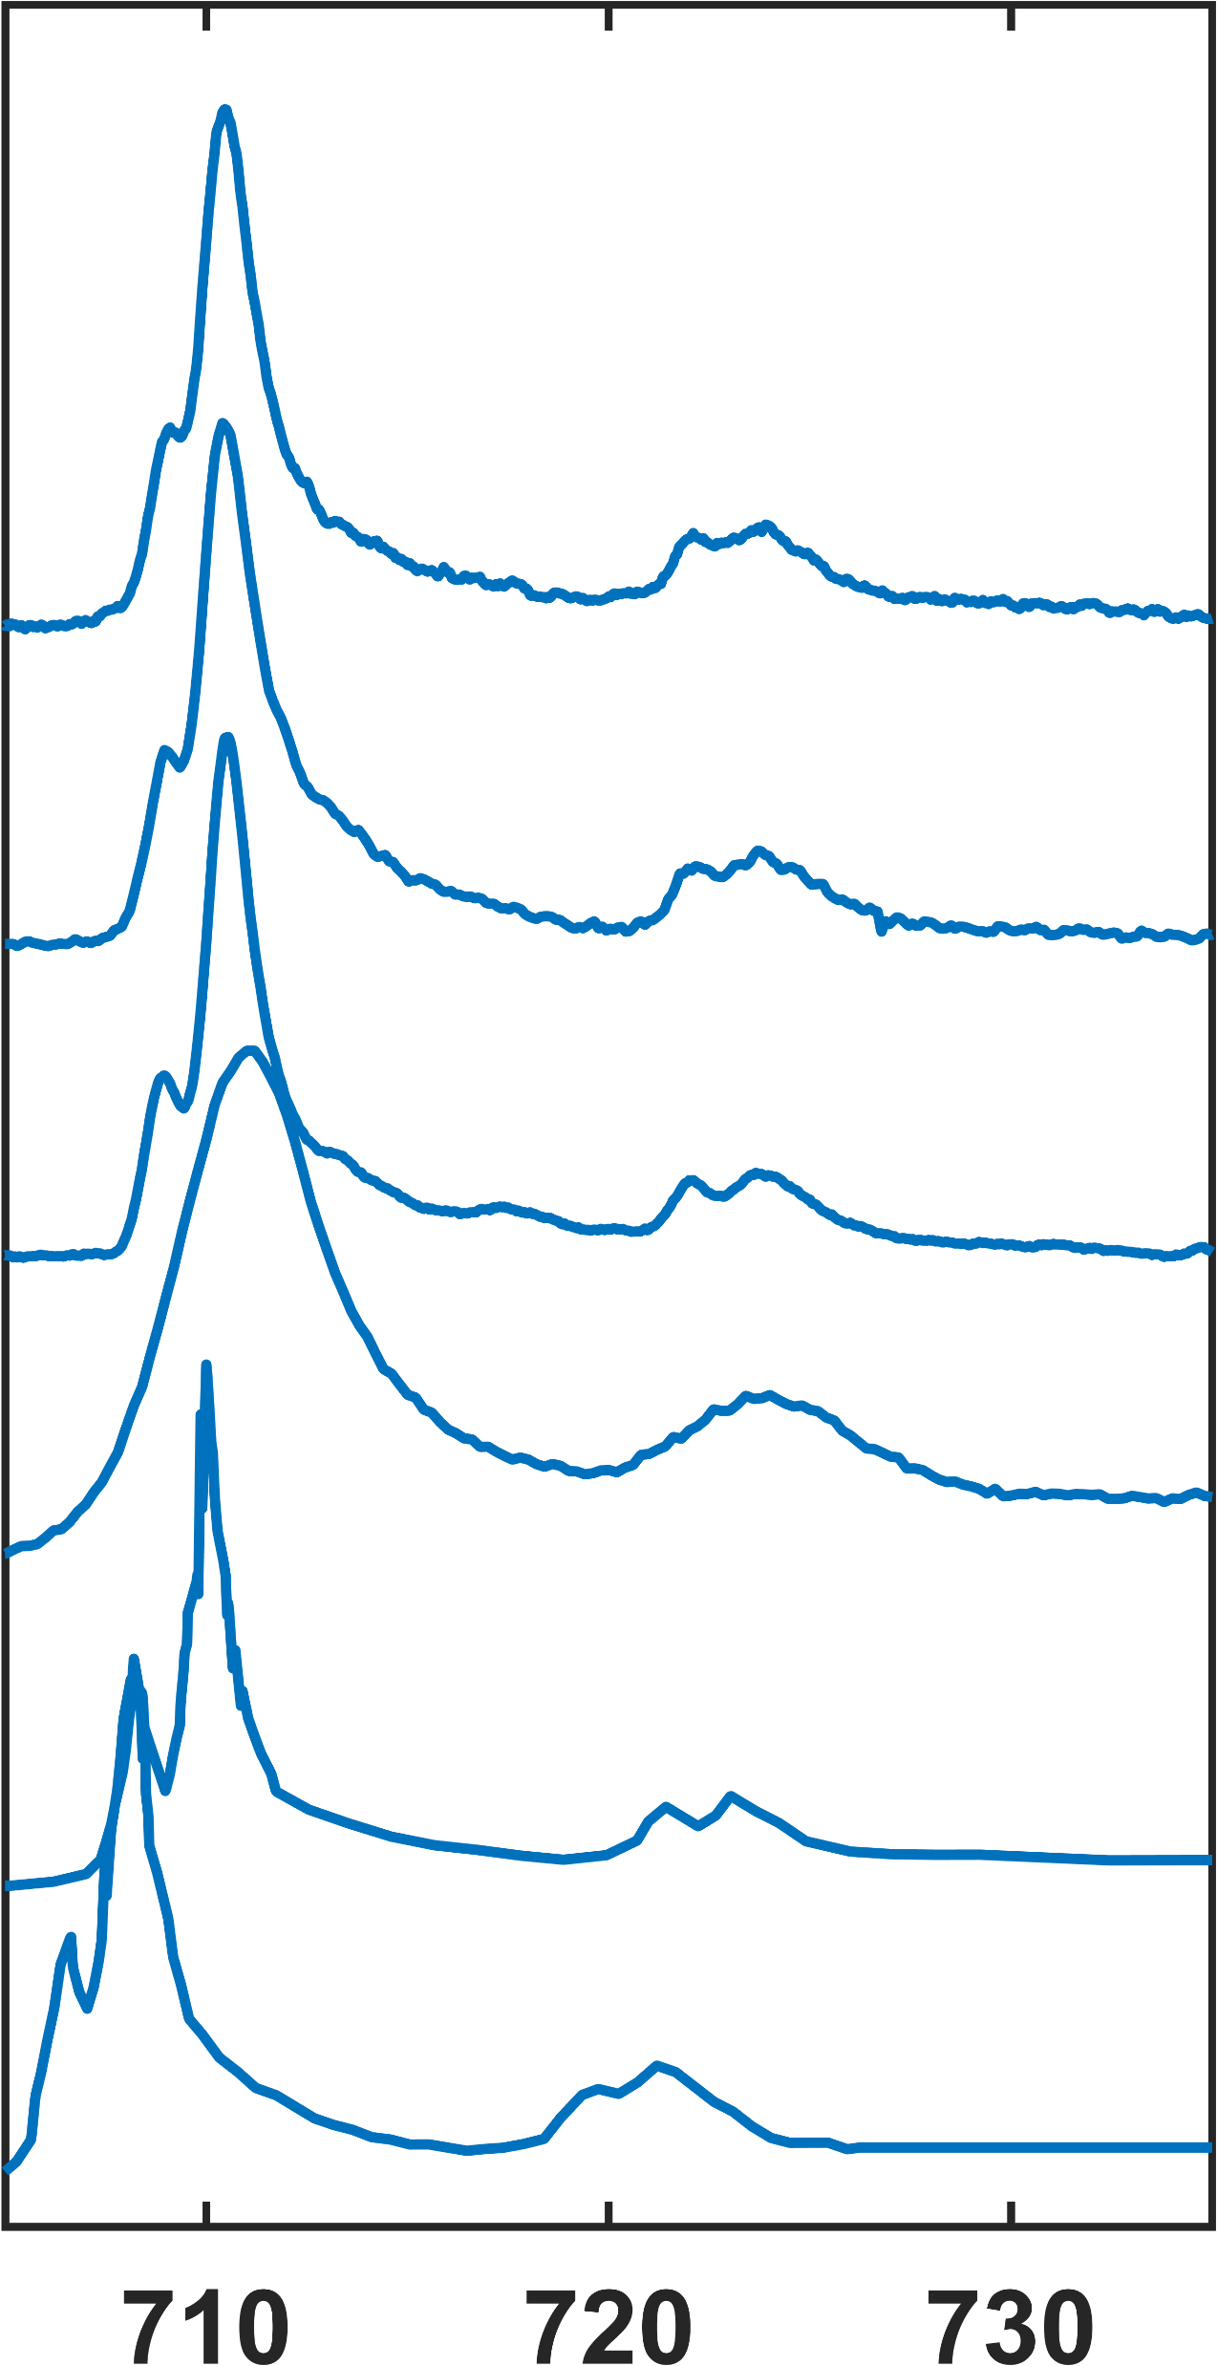
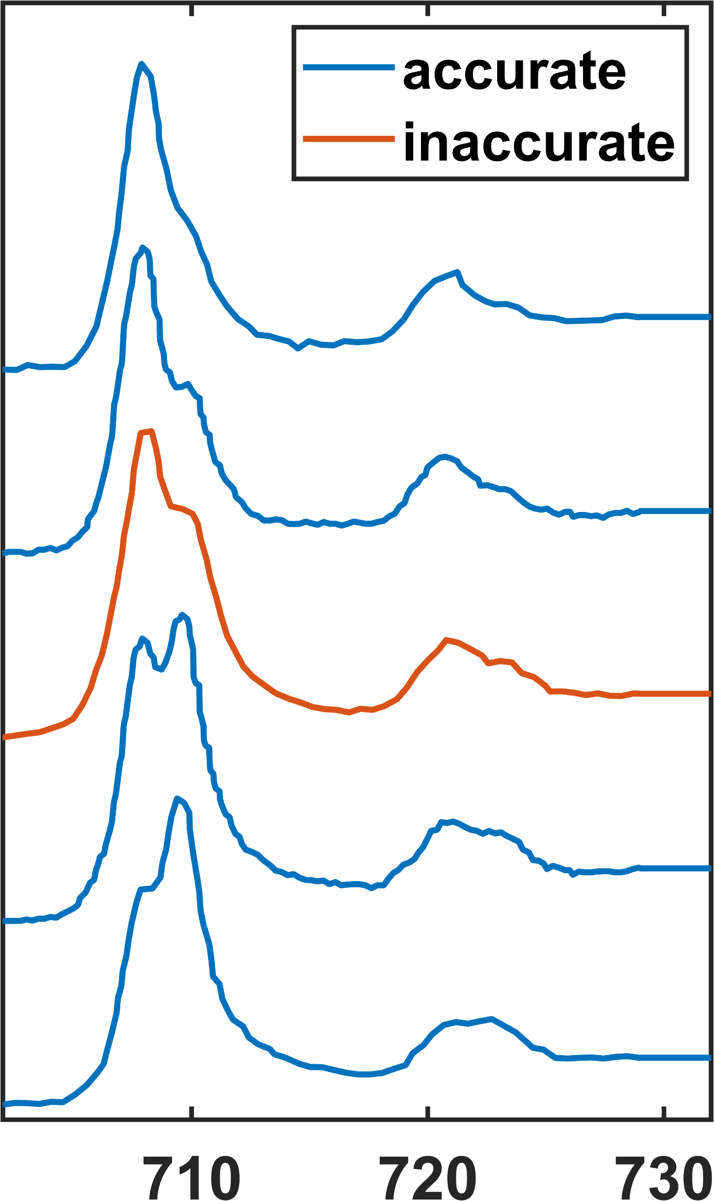
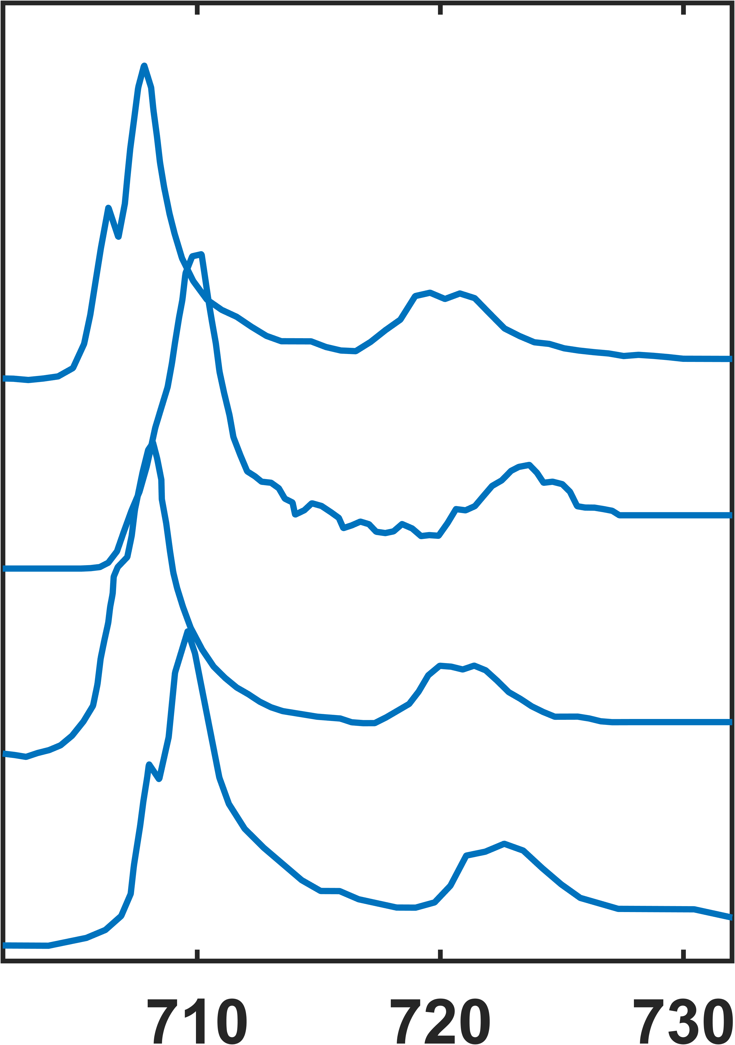
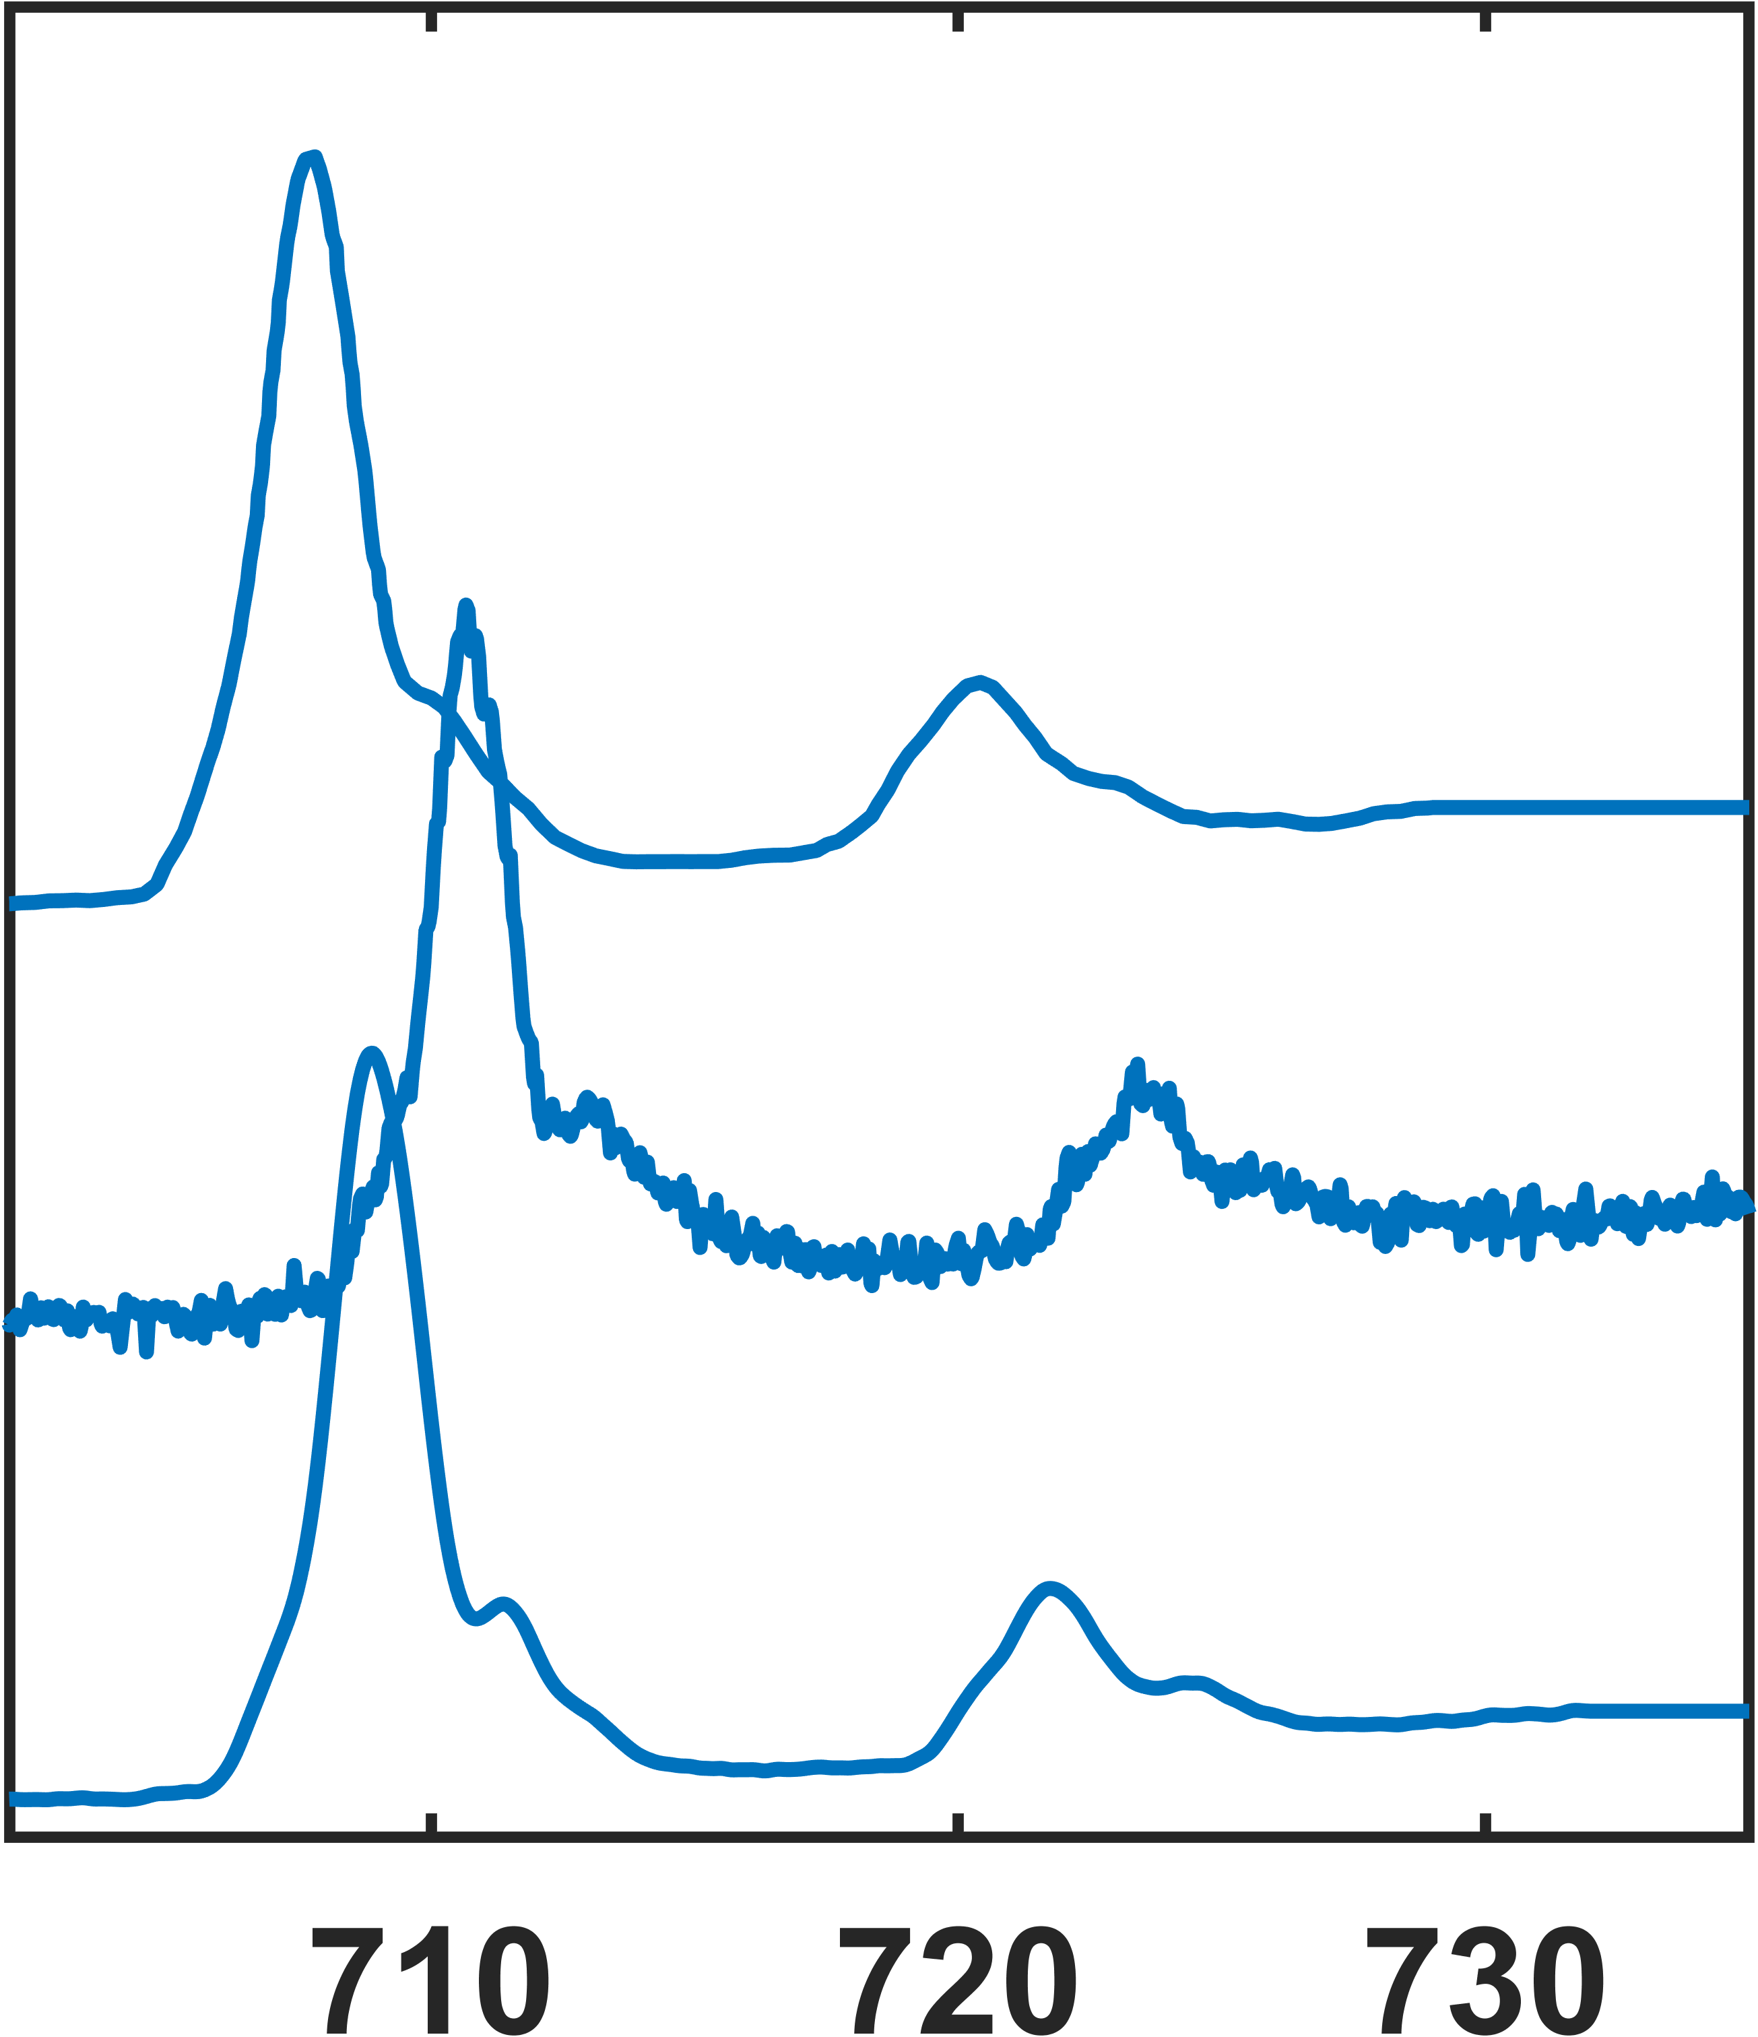
Fe2O3
glass7
[82.99% 17.01%]
[26.7% 73.3%]
FeO(OH) [5.6% 94.4%]
spinel KR35
[86.71% 13.29%]
[3.69% 96.31%]
FeO(OH) [3.58% 96.42%]
augite CVF1
[81.18% 18.82%]
[3.57% 96.43%]
FeO(OH) [0.47% 99.53%]
Fe2TiO5 [7.6% 92.4%]
amphibole SC1
[38.32% 61.68%]
[2.47% 97.53%]
amphibole LC3
[30.71% 69.29%]
LaFeO3 [1.67% 98.33%]
[4.86% 95.14%]
Intensity (a.u.)
FeO(OH) [9.94% 90.06%]
[5.85% 94.15%]
Fe3O4
[16.98% 83.02%]
[30.46% 69.54%]
[0.04% 99.6%]
[30.37% 69.63%]
FeO [97.8% 2.2%]
[16.53% 83.47%]
FeTiO3 [94.82% 5.18%]
[35.66% 64.34%]
[12.32% 87.68%]
FeCO3 [99.35% 00.65%]
[31.14% 68.86%]
Energy Loss (eV)

Slide 18
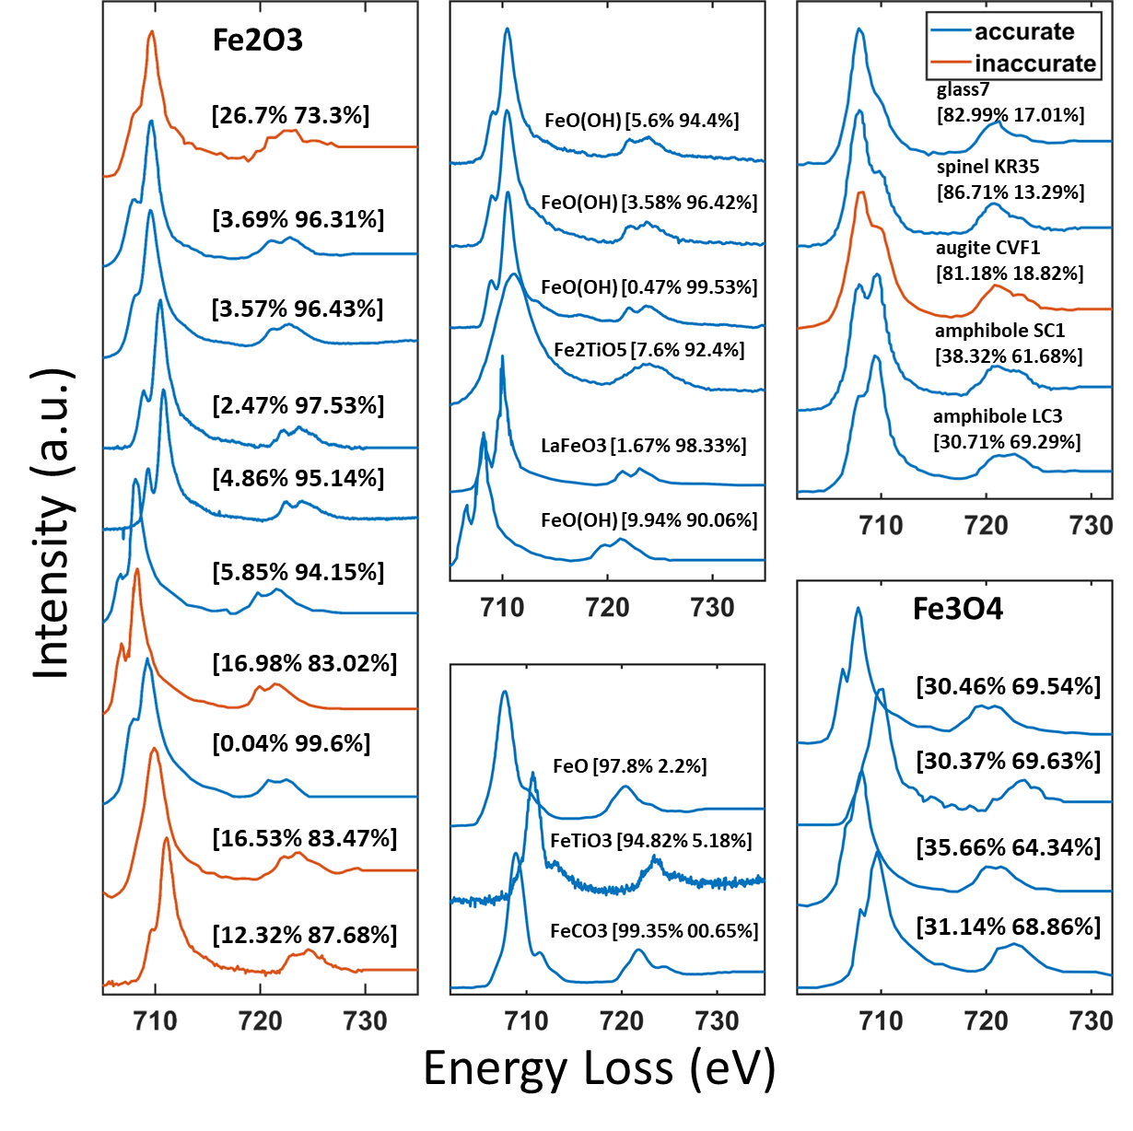

Slide 19
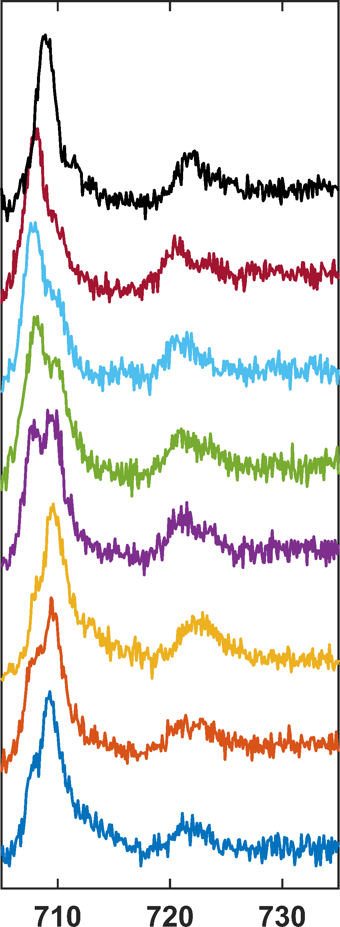
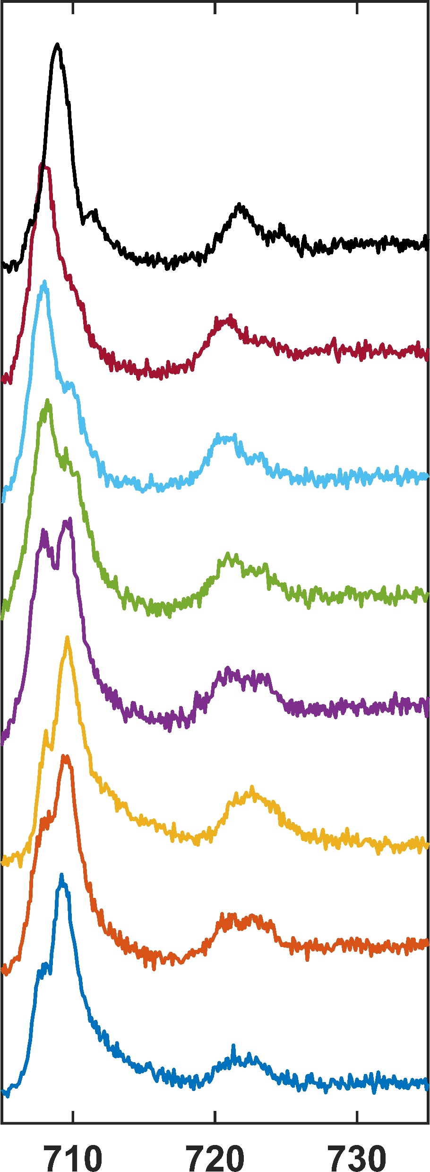
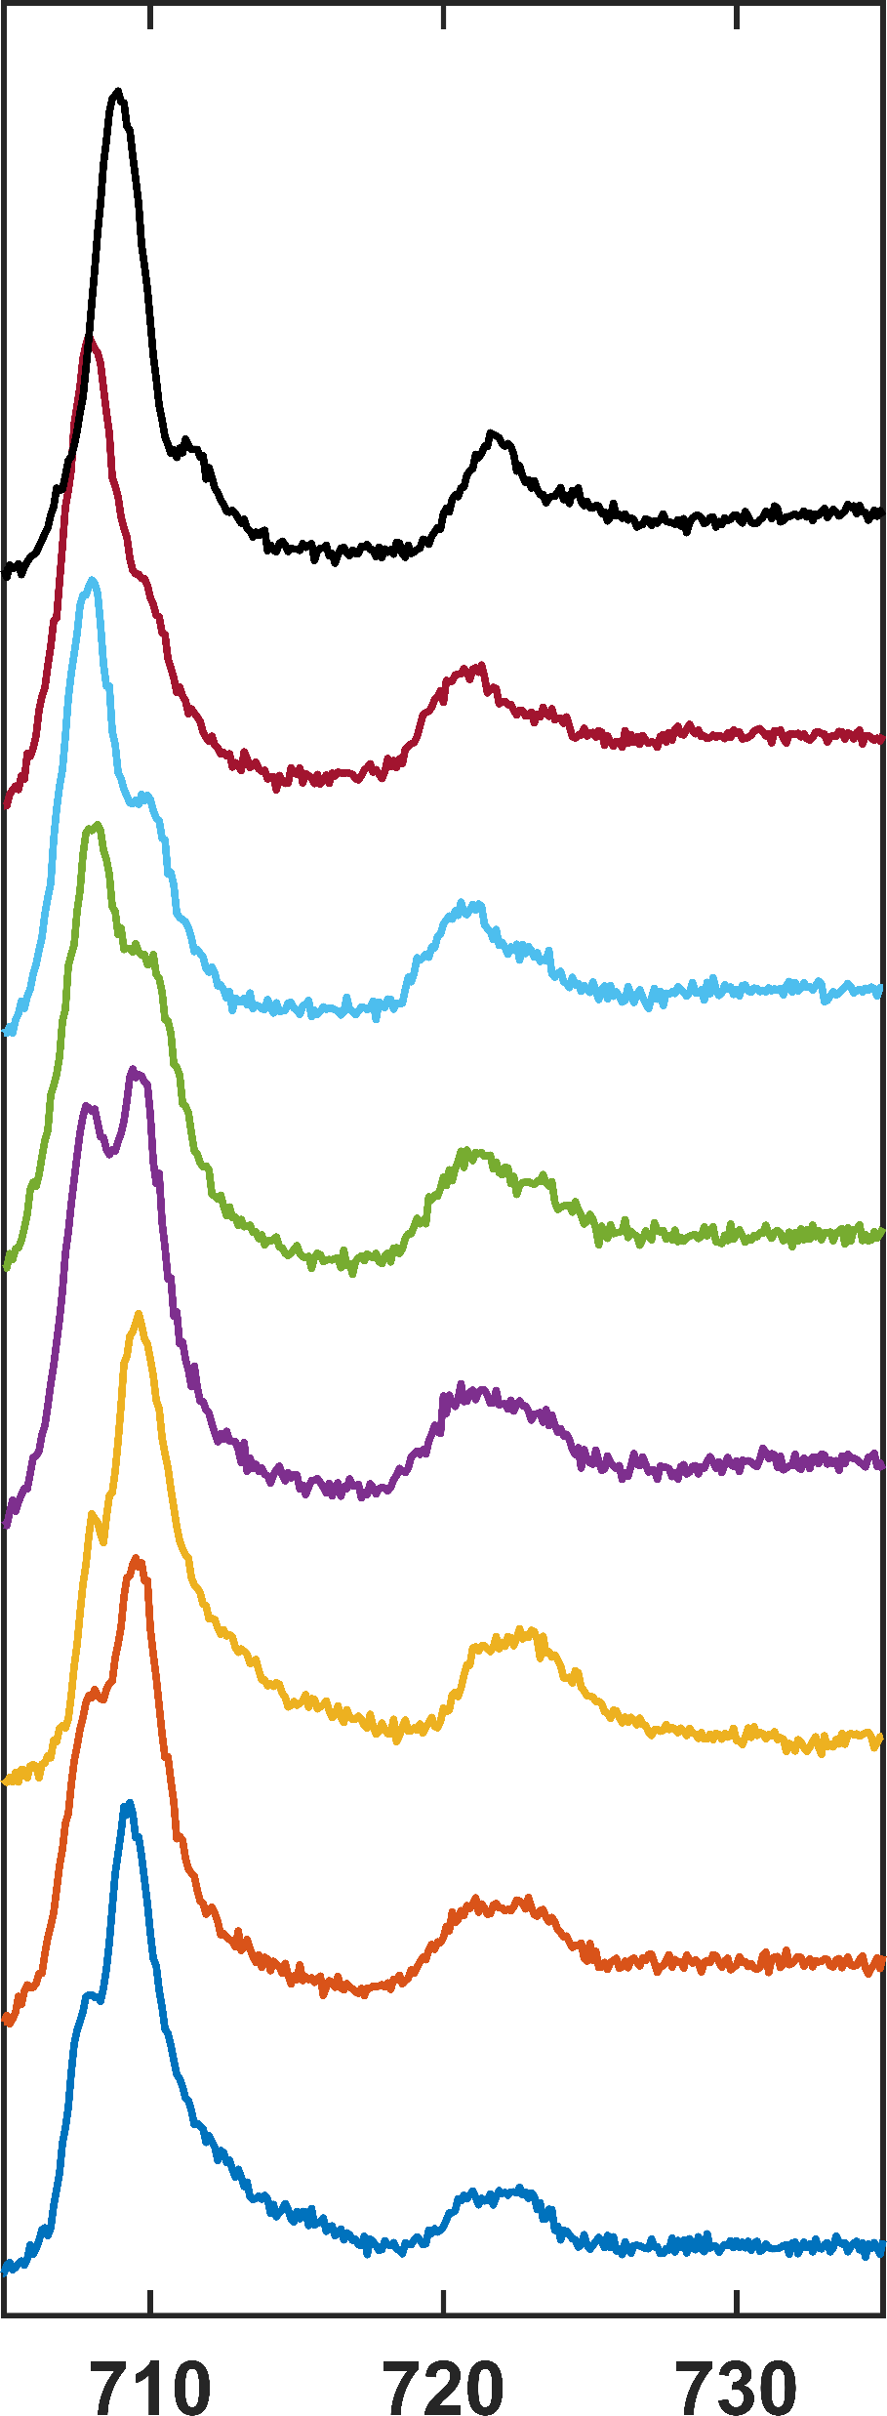
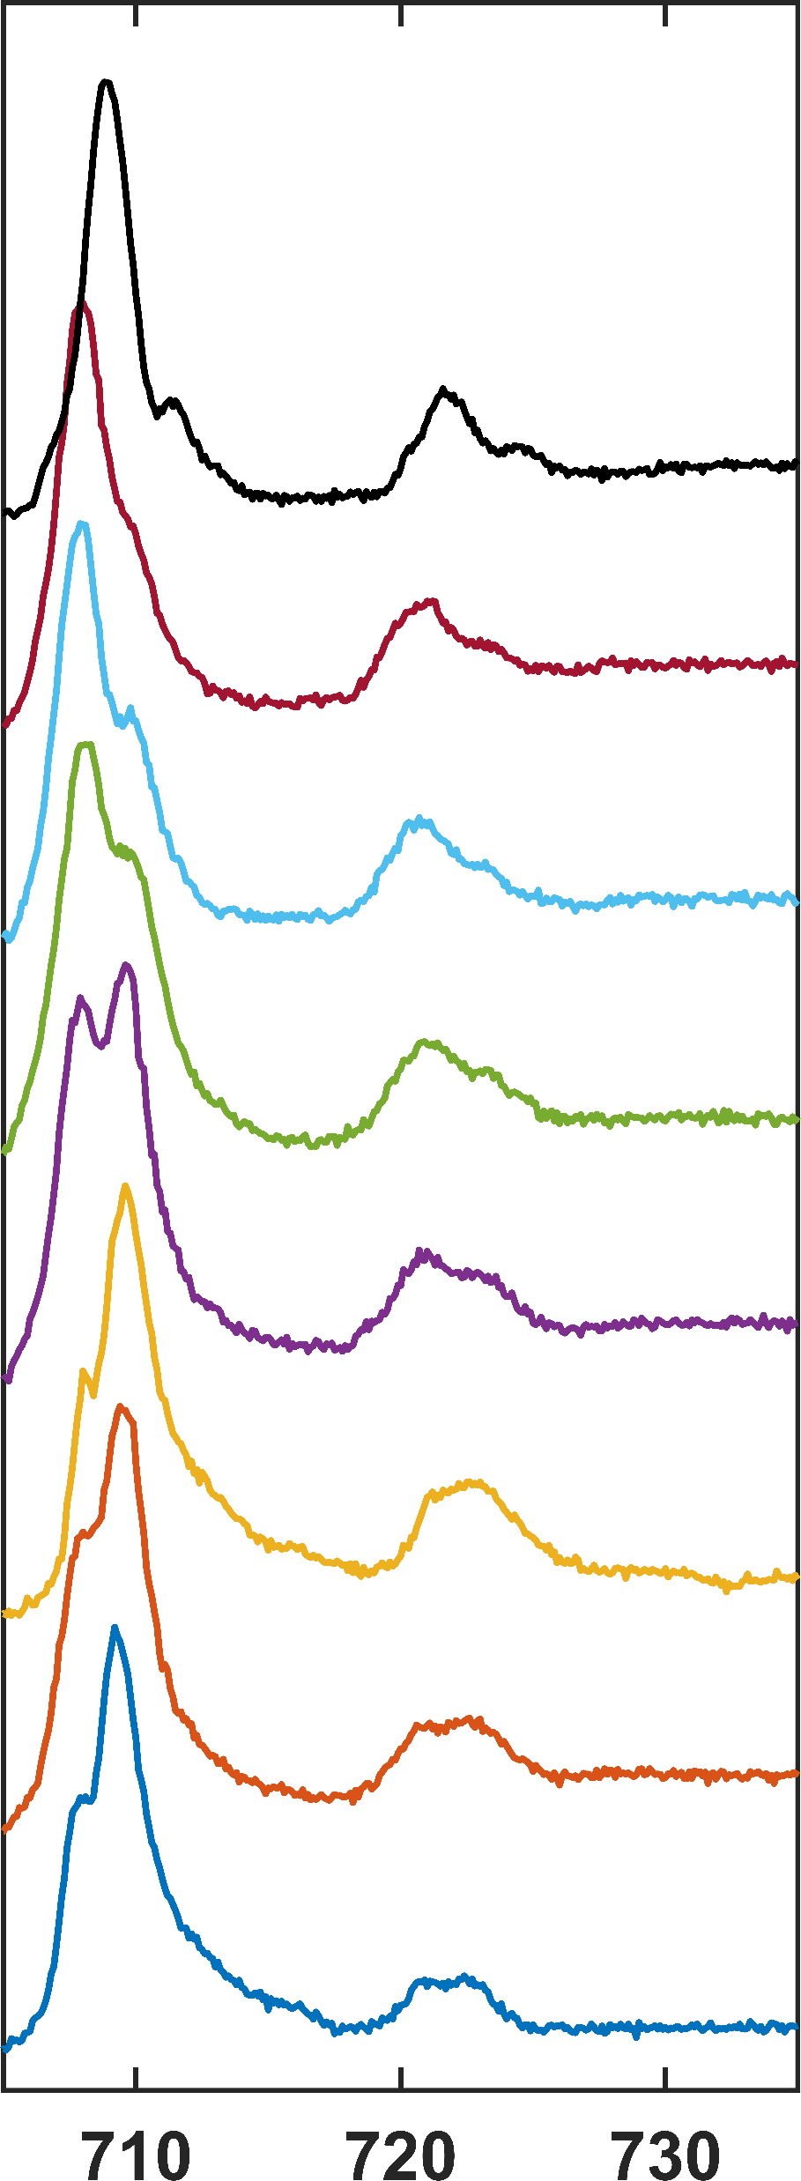
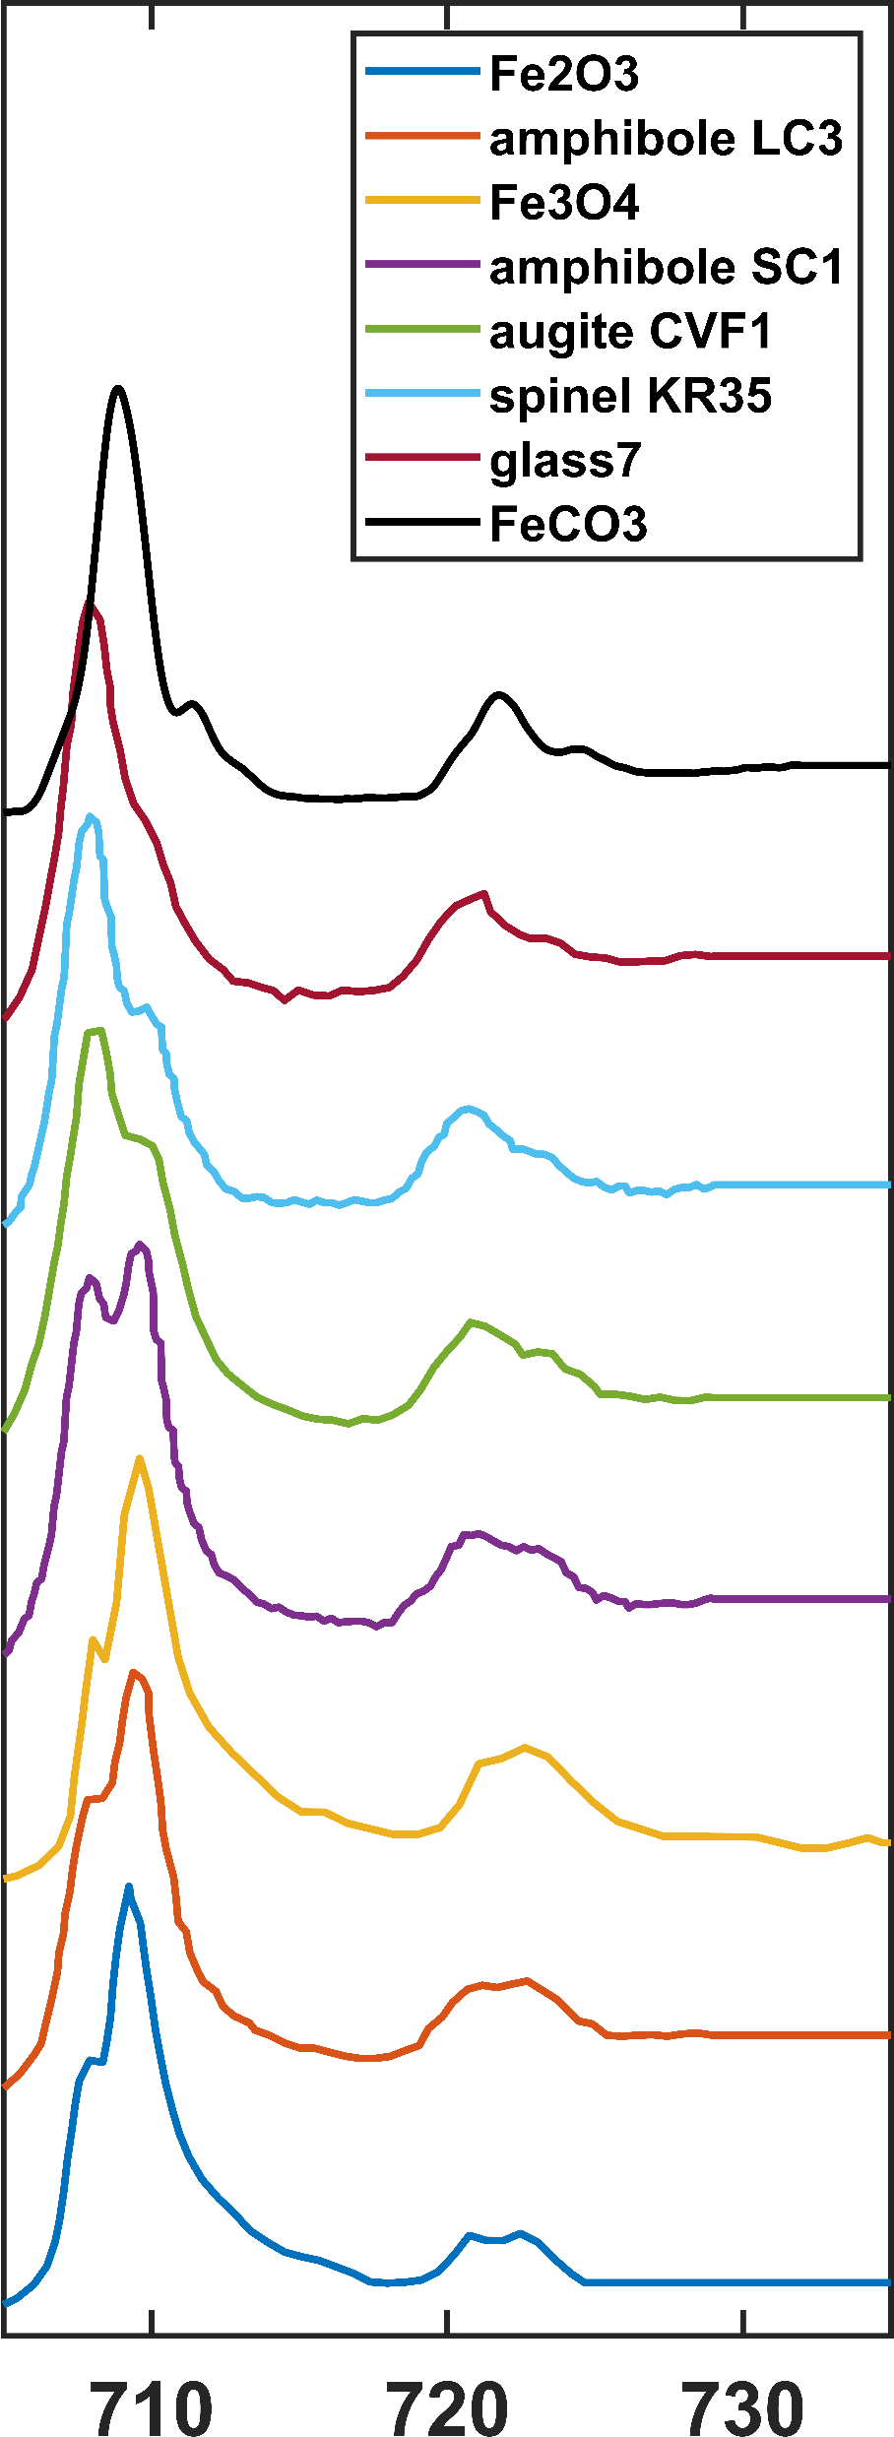
SNR = 5
SNR = 10
SNR = 20
SNR = 30
Original
Intensity (a.u.)
Energy Loss (eV)

Slide 20
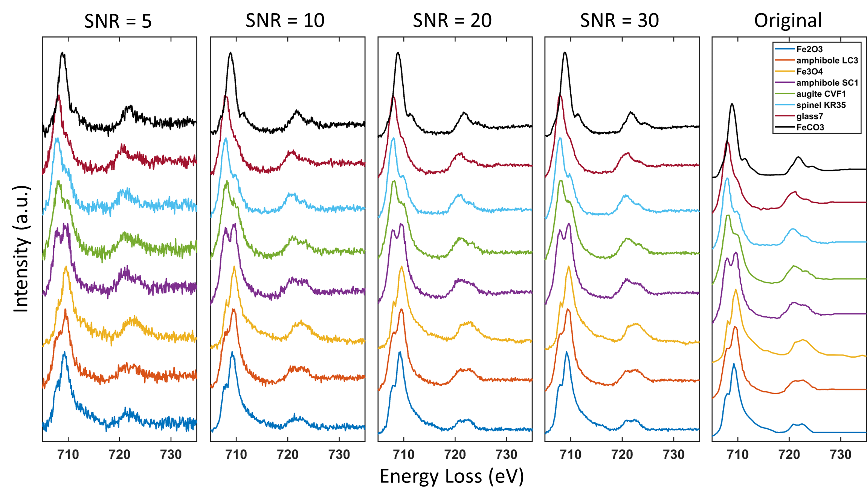

Slide 21
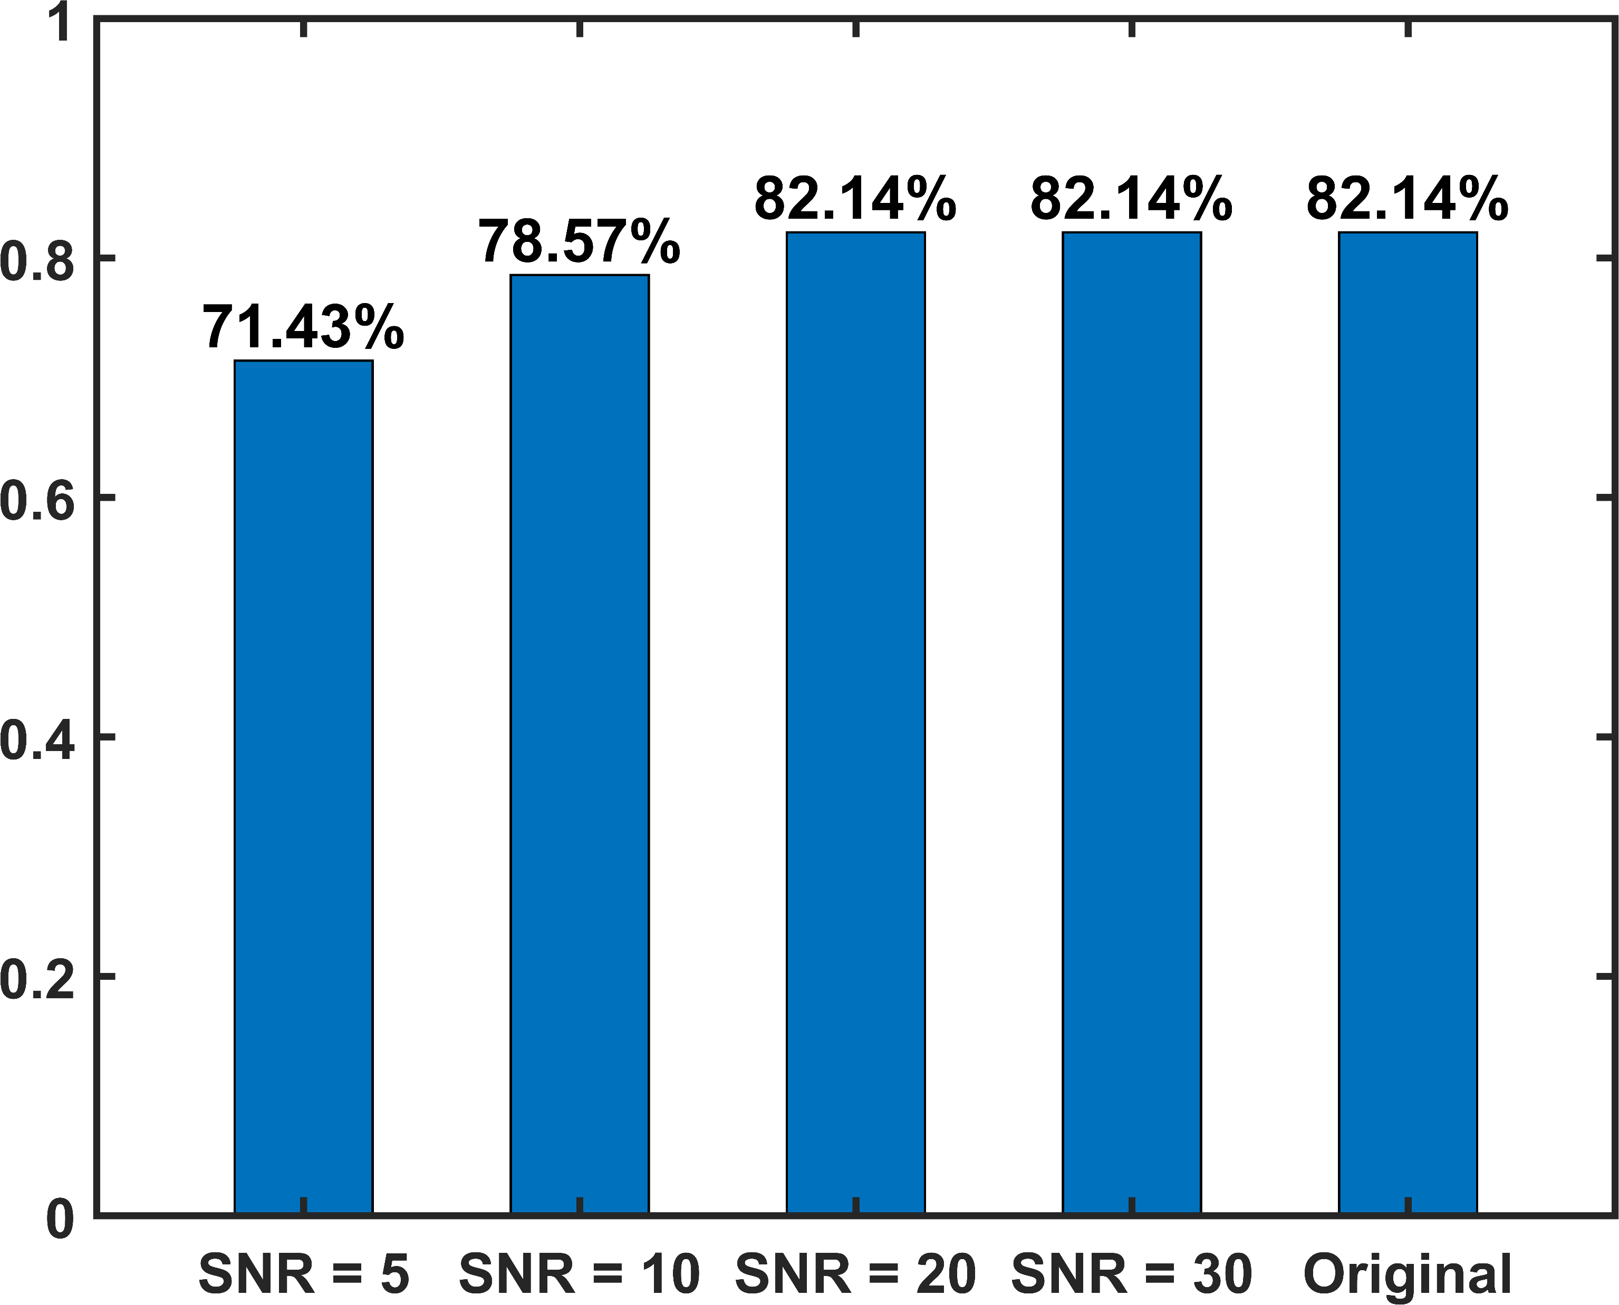
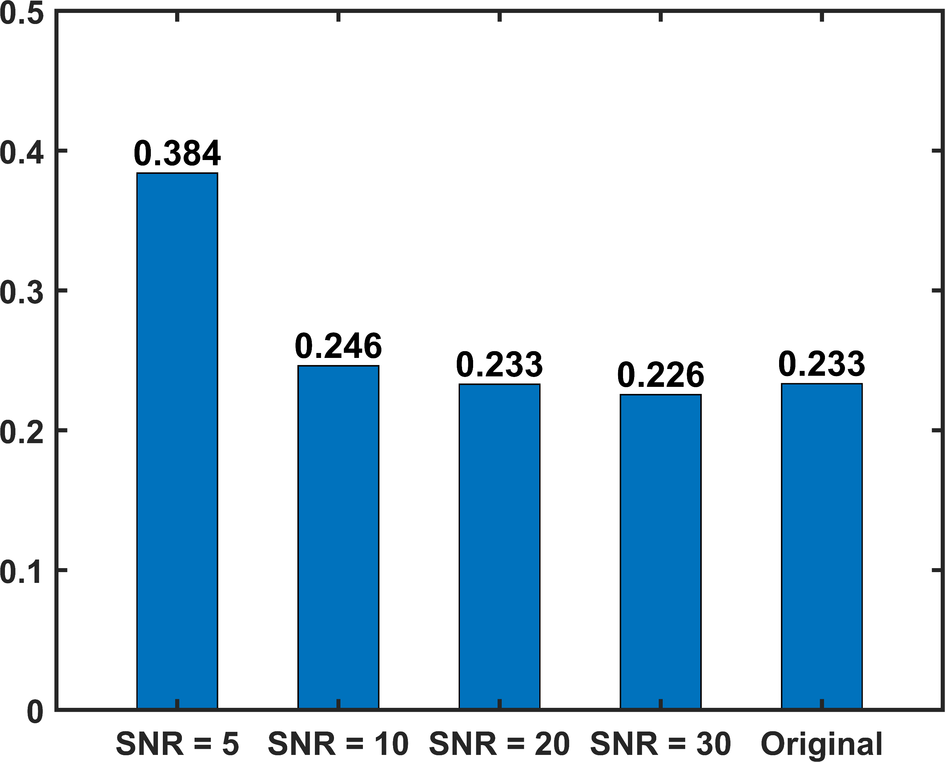
Accuracy (%)
MSE Loss

Slide 22
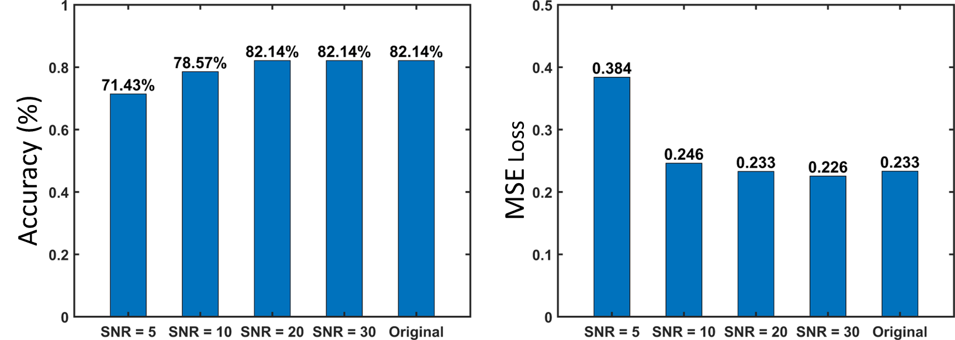

Slide 23
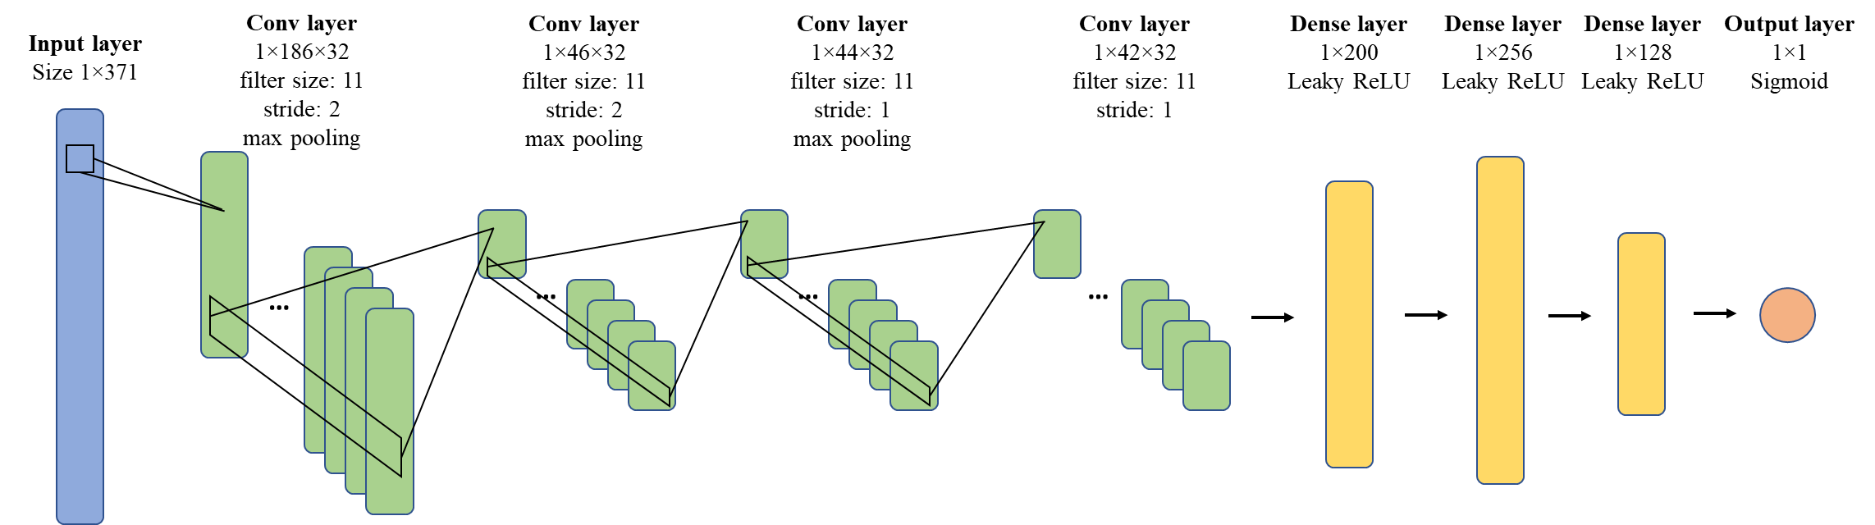

Slide 24
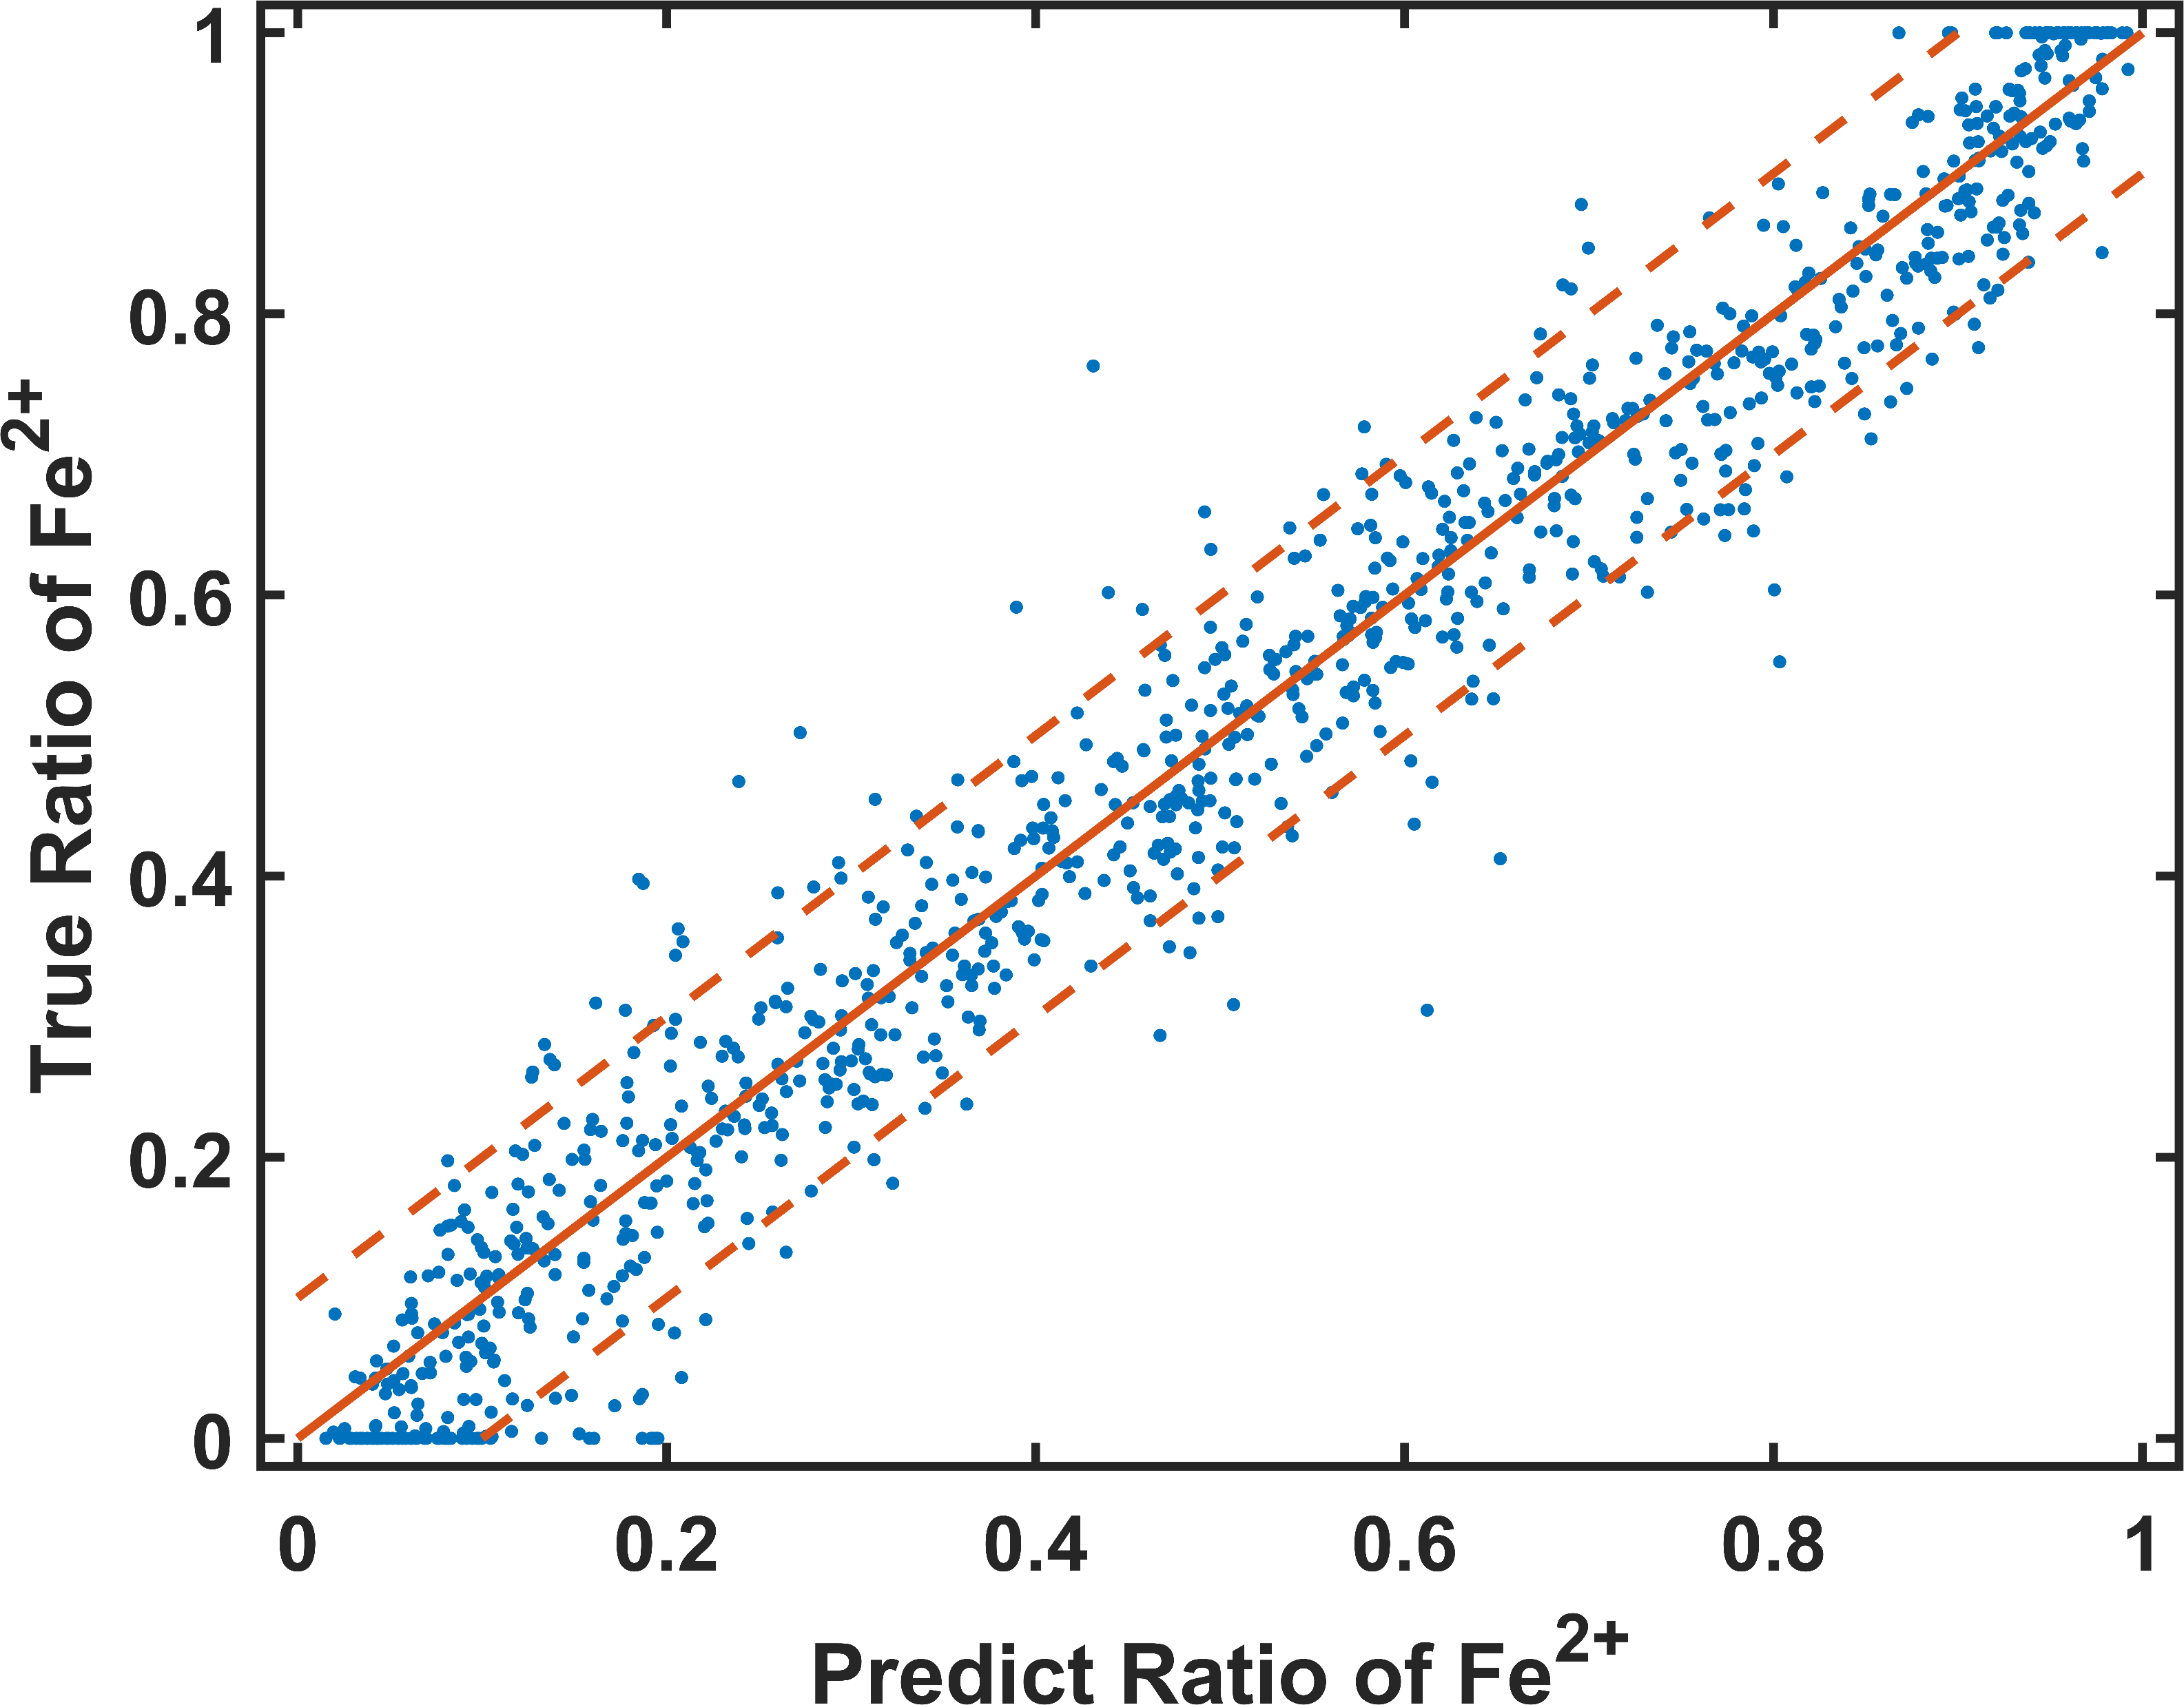
Under Prediction
Over Prediction

Slide 25
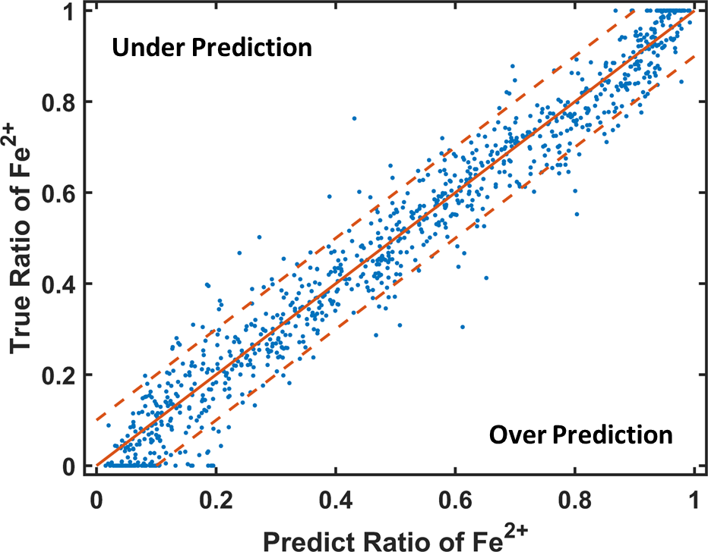

Slide 26



Intensity (a.u.)
Energy Loss (eV)

Slide 27


